Slide 1
How to customize this training for your jurisdiction
Remove this slide after you have customized this presentation
This training is intended to be part of your training for poll workers, focusing on how to assist voters with disabilities, while supporting private and independent voting.
In the slides:
Text and image placeholders highlighted in grey should be customized to your own voting systems and procedures (and then removing the highlight)
There are also customization notes on some slides in a grey box on the right that should be removed
Slide notes contain additional information you might want to use in your training.
Some slides can be removed if they do not apply to your jurisdiction.

Slide 2
Preparing for federal agents or ICE at a polling place
Put your jurisdiction name, logo, or other credits here

Slide 3
What do if military or federal agents enter a voting area?
This includes an election office, polling place, vote center, drop box, or any election or ballot tabulation site.
Your primary responsibility is to stay calm and keep voting going.
The goal of this training is to provide you with the process and scripts to respond confidently and successfully to any situation that comes up
These plans build on all of your other emergency planning, so these slides focus on this one type of emergency.

Slide 4
Federal laws govern who may be in a polling place.
Federal law prohibits military or federal agents from being present at election sites. Military or federal officials from stationing troops or armed men where elections are held.
This includes federal law enforcement, not just troops.
Members of the military from interfering with elections
Civilian federal employees from using their \position to influence federal elections.
Two federal laws apply to both private citizens and public officials
One prohibits intimidating anyone aiding a voter
Another makes it a crime to conspire to threaten or intimidate anyone from exercising their constitutional rights, which includes the right to vote.

Slide 5
State laws also set rule for presence at a polling place
✔️ Allowed
Official observers
Candidates
Official Department of Justice election monitors
Local law enforcement officers
❌ NOT allowed within the safety perimeter
Violent behavior
Disrupting voting lines or blocking the entrance
Following or harassing voters
Aggressively questioning voters
Brandishing firearms or an intimidating display of firearms
Approaching voter vehicles or writing down license plate numbers

Slide 6
If something happens…
Call to the [Election Worker Hotline] immediately.
[ where - phone number ]
even if you don’t have all the information
If the situation escalated or if anyone is in danger
Call 911
Then call the [Election Worker Hotline]

Slide 7
Our response plan
Preparing the polling place with more information
Setting up polling places to make the boundaries clearer
Make the safety perimeter more visible. You will mark it with [cones/tape/chalk].
Post signs about who is allowed in the polling place
Providing you with information and a polling place kit with
Contact information and who to call first
An outline of the responses we will practice today
A de-escalation pocket guide and other information
A reporting form

Slide 8
If federal agents enter the voting location/polling place
Stay calm and keep voting going.
Ask for information about their purpose without obstructing them or sounding aggressive or frightened.
Don’t escalate the danger with confrontations.
Gather clear information to report to the election office or other proper authority
Get a supervisor on the phone with the agents to make decisions.
Collect and document what happens during the incident.

Slide 9
What to say when
Reporting an incident
Prepared to clearly, calmly, and concisely report:
Who you are, your location, and why you are calling
What you know about who the agents are, and what has happened
A description of the situations in a sentence, including who is talking to the agents, if anyone.
Ask what the next steps are.

Slide 10
What to say when
Approaching the agents
Don’t raise your voice, touch or block them, or argue about the law
Identify who they are
“Hi, can I get your name and what agency you are from, please?”
“Can I also get your badge number, please?”
Learn their purpose
“Thanks. What’s the purpose of your presence here today?”
Ask for their authority or paperwork
"Are you here under a judicial warrant, court order, or official assignment?” “Can I put you on the phone with [my supervisor], please.”

Slide 11
What to say when
Informing them of election procedures
State the rules of the polling place. Try to connect them to a supervisor.
“I have [my supervisor] on the phone. They would like to speak with you.”
“My instructions are that only voters or accredited observers are allowed inside the polling place. Can you give me a minute to get my supervisor on the phone?”
“Would you please step [over here] with me, so that we don’t disturb the people who are here to vote?”

Slide 12
What to say when
Interacting with voters
Keep voters safe and keep voting going until a supervisor or law enforcement arrives.
You might have to rearrange the lines or flow of traffic in the polling place.
“Could you move this line over here so we can keep everything orderly?”
“We’re moving the line to [here]. Stay in the same order, and we’ll direct you to the check-in table when the next worker is ready for you.”

Slide 13
What to say
After the incident or when people start to leace
Try to get names and contact information for anyone who was present.
“Thank you for voting. Would you be willing to leave your name and a contact phone number or email?
You were in the polling place and witnessed this incident. We might want to contact you later when we write up our report.”

Slide 14
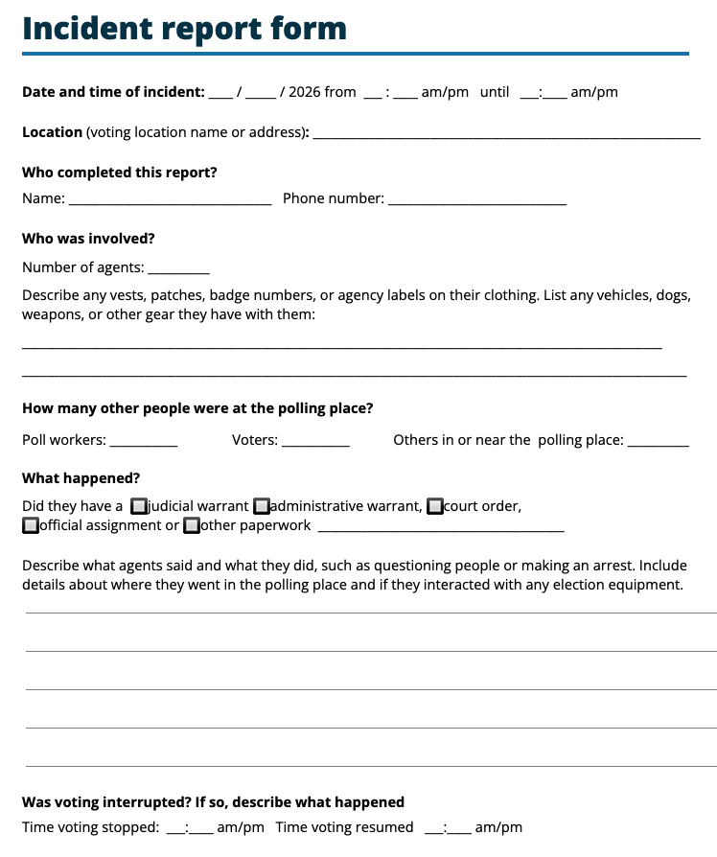
Reporting what happened
Taking good notes
Take as many notes as you can.
The stress of the moment can make it hard to remember details, so even a few simple words can help them provide an accurate report afterward.
  Tall man. Maybe in his 30’s. Showed
  an FBI badge. Name - Steve.
Then, when it is over, the we can all put together a report.

Slide 15
Reporting what happened
Use this helpful reminder of the information needeed
S Size. Number of people involved
A Activity. What happened
L Location. Where, exactly
U Uniforms - any vests, patches, or agency labels
T Time. When the incident started and any key activities.
E Equipment. - vehicles, dogs, weapons, or other gear
And
How manty voters were in the polling place
Any impacts on voting, including if it stopped and when if was restarted

Slide 16
Let’s practice this!
Get in groups of 6 and we’ll do a little role-playing to try out using the scripts and what to do and say if there is an incident.

Slide 17
How did that go?
What was easy?
What was hard?
What questions do you have?

