Slide 1
Sample slide presentation:
Assisting voters with disabilities at the polling place
These slides are the sample slides described in Training Poll Workers for Accessible Voting: Supporting Voters with Disabilities at the Polling Place.
Instructions are on slide 2.
The sample slide deck starts with slide 3. Remove slides 1 and 2, when you customize.
Notes:
This slide presentation sample is a companion document to Blahovec, S., Quesenbery, W., Laskowski, S. (2023) Training Poll Workers for Accessible Voting: Supporting Voters with Disabilities at the Polling Place. (National Institute of Standards and Technology, Gaithersburg, MD), NIST Voting Technology Series (VTS) 100-2. https://doi.org/10.6028/NIST.VTS.100-2
It is available free of charge at https://doi.org/10.6028/NIST.VTS.100-2sup1
Disclaimer: Certain commercial equipment, instruments, software, or materials, commercial or non-commercial, are identified in this paper in order to specify the experimental procedure adequately. Such identification does not imply recommendation or endorsement of any product or service by NIST, nor does it imply that the materials or equipment identified are necessarily the best available for the purpose.

Slide 2
How to customize this training for your jurisdiction
This training is intended to be part of your training for poll workers, focusing on how to assist voters with disabilities, while supporting private and independent voting.
In the slides:
Text and image placeholders highlighted in grey should be customized to your own voting systems and procedures (and then removing the highlight)
There are also customization notes on some slides in a grey box on the right that should be removed
Slide notes contain additional information you might want to use in your training.
Some slides can be removed if they do not apply to your jurisdiction.
Remove this slide after you have customized this presentation

Slide 3
Assisting voters with disabilities at the polling place
Put your jurisdiction name, logo, or other credits here

Slide 4
About this training
This module of poll worker training covers:
Disability rights during voting
Accessible voting systems
Assisting voters with disabilities
How to assist voters
  Checking in a voter
  Setting up the voting system
  While they are voting
  While they are verifying and casting their ballot
Summary and resources

Slide 5
Disability rights during voting
“There needs to be equal access to the ballot box so people with disabilities can exercise their constitutional right to vote.”
Voter comment
from (page 7 of the RFI)
Public comment from NIST Request for Information for E.O. 14019, Promoting Access to Voting
Notes:
The RFI link is https://www.federalregister.gov/documents/2021/06/16/2021-12619/promoting-access-to-voting
The responses are at Regulations.GOV at https://www.regulations.gov/search/comment?filter=2021-12619

Slide 6
What is a disability?
The Americans with Disabilities Act of 1990 says:
The term “disability” means, with respect to an individual:
(A) a physical or mental impairment that substantially limits one or more major life activities of such individual;
(B) a record of such an impairment; or
(C) being regarded as having such an impairment.

Slide 7
What rights do voters with disabilities have?
Accessible voting systems are required by the Help America Vote Act (HAVA).
Every voter with and without a disability has the right to use an accessible voting system
Some voters with disabilities need the accessible voting system to vote privately and independently, especially:
  Voters who are blind or have low vision
  Voters with mobility disabilities or lack manual dexterity
  Voters with cognitive disabilities
Voters may use a screen magnifier on their phone, even if phones are not permitted in the polling place
Notes:
Every voter has a right to use the accessible voting system. However, some voters with disabilities need to use the accessible voting machine to vote privately and independently because they can’t independently hand mark a paper ballot. Voters with disabilities have the same right to vote privately and independently as voters without disabilities. If there was no accessible voting machine, some voters might not be able to read or mark their ballot by themselves and would have to have an assistant or poll workers mark their ballots for them. Some voters may still need or want help with voting, but accessible voting machines are an option and an accommodation that may give them more privacy and independence.
The Help America Vote Act of 2002 requires that every polling place has at least one accessible voting machine for voters with disabilities
Some voters may use a screen magnifier on their phone. Even if phones are not permitted in the polling place, this is an essential accommodation for some voters with vision disabilities and they must be allowed to use the screen magnifier.

Slide 8
What are the accessibility requirements for voting systems?
The federal standards, called Voluntary Voting System Guidelines (VVSG) 2.0, say that systems must provide:
Equivalent and consistent voter access, with equivalent information and options in all modes of voting
Voter privacy so people can vote privately and independently (without assistance from others)
Voters can mark, verify and cast their ballot as they intend because ballots are presented in way they can perceive (see or hear), operate the system, and understand the ballot information and instructions
Notes:
Voluntary Voting System Guidelines (VVSG) 2.0, principles 5 - 8
The VVSG are a set of specifications and requirements against which voting systems can be tested to determine if they meet required standards. Some factors examined under these tests include basic functionality, accessibility, and security capabilities. While the Help America Vote Act (HAVA) mandates the EAC to develop and maintain these requirements, adhering to the VVSG is voluntary except in select states that require it by law.
https://www.eac.gov/voting-equipment/voluntary-voting-system-guidelines

Slide 9
Accessible voting systems
A voting system is “accessible for individuals with disabilities, including nonvisual accessibility for the blind and visually impaired”, if it “provides the same opportunity for access and participation (including privacy and independence) as for other voters.”
Help America Vote Act of 2002 Section 301

Slide 10
How do accessible voting systems support voters?
What it does | How it helps
Audio ballot | Helps voters who are blind, have low vision, or who do not read well, by reading the ballot aloud
Tactile controller and other assistive devices | Allows voters using the audio ballot or people with mobility disabilities to navigate and make their choices with buttons they can identify by touch
Setting text size | Helps voters with low vision and cognitive disabilities by making the text easier to see
Changing contrast | Allows voters with low vision to make the text stand out from the background
Personal assistive technology | In some systems, voters can bring their own input controls (assistive technology) or hearing devices
Put a photo of your systems controller here.
A tactile controller has physical buttons that can be identified by touch.
Notes:
For example:
Blind voters can use the audio feature on voting machines to read the ballot to them and allow them to mark the ballot with the accessible controller
Voters with low vision can use the accessible machine for the audio feature, make the text larger, or change the contrast on the machine
Voters with some mobility and dexterity disabilities might not be able to hold a pen and mark their ballot. They can use the controller [or their own assistive technology, such as a sip and puff device] to mark their ballot
Some voters with cognitive disabilities might choose to use a ballot-marking device to enlarge the text or read the ballot to them
Some voters, with and without disabilities, may find it easier to vote on an accessible voting machine and prefer that to voting on a paper ballot

Slide 11
Our accessible voting system:
[insert name of your system here]
The features of this system include:
[Audio ballot]
[Tactile controls]
[Change text size and contrast]
[Sip-and-puff controls]
[Ability to plug in their own assistive technology]
[Set up at a height for sitting]
[add any more, remove any you don’t have]
You can learn more about these features at [poll worker manual reference]
Put a photo of your system here.
If you have an illustration with callouts to identify accessible features, you can use it here.
Notes:
How to use this slide
Insert a picture of your accessible voting system.
Use this slide to make sure poll workers know what features are available so that they can inform voters and help them find those features. Check the manufacturer’s instruction manual to learn what features are available on your machine, such as
An audio ballot
The option to make text larger or smaller
The option to change the contrast on the screen
The ability to turn the screen off when in audio mode
A controller with buttons (this may be attached to the machine)
A headset (this may be attached to the machine)
A way for voters to plug in their own assistive devices, such as sip and puff systems, dual switches, or rocker paddles
Demonstrate how poll workers can navigate to the feature settings on the machine, such as audio mode
Let poll workers know how they can find more information on the features on Election Day, such as in the poll worker manual or any job aids
Consider creating a checklist of the accessible features that are available for poll workers to reference on Election Day

Slide 12
Assisting voters with disabilities
[The poll workers] “explained the operation and voting procedure very clearly. After filling out my ballot by myself and completing the whole process, I had a wonderful feeling of self-satisfaction being able to do my civic duty to vote.”
Public comment from NIST Request for Information for E.O. 14019, Promoting Access to Voting

Slide 13
What tools do you have to help you assist voters?
Customize this slide to match what your poll workers have available.
In all the slides text that needs customization is highlighted in grey
Use this slide to introduce
Procedures and forms
Job aids for the accessible voting system features
ASL interpreters if available remotely or in the polling place
Who to contact if you need help troubleshooting a problem
Notes:
How to use this slide
Remind the poll workers of the tools they have available for them. This is a good opportunity to make sure they have seen all of the job aids and forms, especially any that are not in their manuals.
They should know who to ask in the polling place if there is a problem with the machine, and the chain of command for fixing those problems.
They should also know where to find any information on the voting machines, such as the polling place manual or any other job aids.

Slide 14
Who may assist voters?
Update the language on this slide to reflect your state’s rules around poll workers providing assistance (such as if the state requires two poll workers from opposing parties to assist a voter)
If your state has specific restrictions or rules around who can and cannot assist a voter, insert those rules on this slide.
If voters need help setting up the voting system or marking their ballot, they are entitled to assistance.
Who may assist voters:
A person of the voter’s choice, such as a family member or personal care attendant
[A poll worker] or [Two poll workers from different parties]
[Insert any other state rules or procedures]
Who may not assist voters:
A voter’s employer or an agent of their employer
An officer or agent of the voter’s union
[Insert any other state rules or procedures]
Notes:
Voters have a right to receive assistance in the polling place. By federal law, voters with a disability have a right to receive assistance from a person of the voter’s choice, as long as that assistant is not the voter’s employer or agent of their employer, or an officer or agent of the voter’s union.
Don’t question whether a voter receiving assistance is not competent to vote. That decision can only be made by a court or guardian.

Slide 15
Fill in the form for assistants as part of the election record
Remove this slide if this is not required in your jurisdiction.
The names of people who assist a voter are recorded on the [Title of the Form].
Collect their
Full name
Relationship to the voter
Address
Signature
Show a copy of the form, so that poll workers will recognize it.

Slide 16
How can assistance be given fairly and impartially?
When giving assistance, let the voter tell you what kind of help they need.
Let the voter do as much as possible by themselves.
Make your best effort to preserve a voter’s privacy as they mark their ballot.
Be neutral and nonpartisan. Do not give out advice or make comments on a voter’s choice or try to influence a voter’s choice.
Be consistent in the instructions you give, so that all voters get equivalent information.

Slide 17
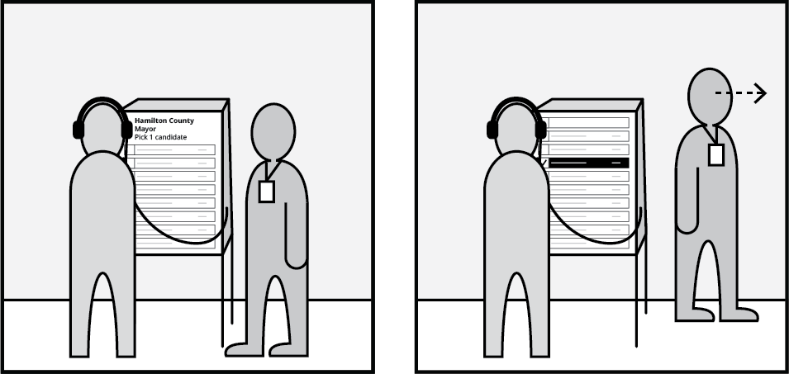
How can assistance support voter privacy while voting?
Emphasize privacy and avoid looking at their ballot once they start voting
Position yourself so they can see you
Don’t look over their shoulder at the screen
After giving assistance, move away to give them privacy
If you are assisting a voter with a vision disability, verbally communicate that you are moving away
Let the voter know how they can get your attention if they need more help
Notes:
When a voter needs assistance, be as minimally intrusive as possible.

Slide 18
Communicating with Deaf, DeafBlind, and hard of hearing voters
Tip for communicating
If they have an interpreter or support person, talk to the voter, not the interpreter
Use gestures
Rephrase your answers
Don’t raise your voice unless asked
Be patient
[ If the polling place has ASL interpretation available, add it here ]
Ways of communicating
There are many different ways to communicate.
Some examples:
Sign language interpreters
Not all Deaf, DeafBlind, or hard of hearing voters use American Sign Language (ASL)
Writing back and forth on a piece of paper
Captioning apps
Notes:
It is very important to be able to communicate with voters when you are assisting them. For voters who are Deaf, DeafBlind, or hard of hearing, there are important considerations to keep in mind.
First, what do we mean by Deaf, DeafBlind, and hard of hearing? These are different but overlapping labels:
Deaf people may have been born without hearing or may have lost their hearing. They may be completely deaf, or they may have lost some of their hearing. Some Deaf people use American Sign Language, while some do not.
DeafBlind people are people who are both deaf and have vision loss
People who are hard of hearing are people who have hearing loss or are deaf but don’t identify with the Deaf label. Some may have mild to moderate hearing loss
Voters who are Deaf, DeafBlind, or Hard of Hearing have different ways to communicate:
If your polling place has American Sign Language interpreters, insert information on interpreters here
If a voter is using an interpreter or has a support person, look at and speak to the voter, not the interpreter.
Example: don’t ask the interpreter “does the voter need help?” Ask the voter, “do you need help?”
Some voters may want to write back and forth on a piece of paper. Have a pad of paper and pen nearby and use those to communicate with the voter
Some voters may use captioning apps on their phone. This will listen to your voice and caption it. Be aware that captioning like this is not always accurate, so be sure to speak clearly and be ready to rephrase your answers if necessary
Don’t be afraid to gesture when communicating with a voter. Use gestures to show where the accessible voting machine is or the different features on the machine
Be patient and be prepared to rephrase your answers if the voter doesn’t understand
Don’t raise your voice at the voter unless they ask you to do that. Just speak clearly and at a regular pace.
Not all Deaf, DeafBlind, or hard of hearing people communicate in the same way. Some may have hearing aids or cochlear implants, and some do not. Some may use American Sign Language, while others do not know how to sign. Ask a voter how they would like to communicate and respect their answer.

Slide 19
How to assist voters:
Checking in a voter
“I have a long wait every time I go to vote [because] the poll workers don't know how to turn the voice on in the voting machine. Sometimes it takes two hours for them to figure out how to turn on the voice…. I have also been asked if someone could help me vote. I deserve to vote independently and privately, as is my right."
Public comment from NIST Request for Information for E.O. 14019, Promoting Access to Voting

Slide 20
Ask voters how they want to vote
All voters have the option to vote on an accessible voting system. Ask them:
“Would you like to vote on a paper ballot, or would you like to use the accessible voting system today?”
Remember
Do not comment on a voter’s choice to use the accessible machine
Not all disabilities are apparent or visible
If a voter wants to vote on the accessible voting system, you may not ask if they have a disability or why they need the machine.
Notes:
How to use this slide: edit these notes for your system.
If using a ballot-marking device with a separate ballot scanner: The accessible voting machine in the polling place is called a ballot-marking device, or BMD. During a voting session, a voter can read their ballot on the screen or have it read to them through the audio ballot. They will make their selections, verify their choices, and print off the ballot. They will then take the ballot to the scanner.
If using a system that casts the ballot at the voting station: The accessible voting machine in the polling place is called a [insert NAME]. During a voting session, a voter can read their ballot on the screen or have it read to them through the audio ballot. They will make their selections, can then verify their choices, and finally the machine will record their vote.
NOTE: If your jurisdiction uses a different name for the accessible voting machine, such as a voter access terminal, change the language of this slide to the term that you use.
All voters have the right to vote on the accessible voting machine, regardless of whether they have a disability. They do not need to prove that they have a disability. Do not make comments on a voter’s choice to use an accessible machine or to handmark a paper ballot.
Best practice: Every voter should be told that they can vote on a paper ballot or the accessible voting machine. Once voters have checked their voter registration and are ready to vote, ask the voter “would you like to vote by hand marking a paper ballot or on the accessible voting machine?”
If your state requires voters to fill out a form, sign an affidavit, or take some other step to use the accessible machine, insert the rules and the procedure for poll workers on the next slide.

Slide 21
When a voter chooses to use the [accessible system]
This slide is only for jurisdictions that have restrictions on who may use the accessible voting system or have a form that a voter must fill out.
This form is different from the one for people who assist a voter.
[If there are any special restrictions, rules or procedures, list them here and show any forms or affidavits that must be filled out.
If anyone can use the accessible system without any special procedures, delete this slide]
Show a copy of the form, so that poll workers will recognize it.

Slide 22
Curbside Voting with an accessible voting system
Remove this slide if this is not used in your jurisdiction.
[If your polling place offers curbside voting with an accessible voting system, describe specific procedures or instructions. Note: curbside voting needs to be ADA-compliant and also not block voters from entering the polling place.]

Slide 23
How to assist voters:
Setting up the voting system
“I have a long wait every time I go to vote. The primary issue is the poll workers don't know how to turn the voice on in the voting machine. Sometimes it takes two hours for them to figure out how to turn on the voice, and I sit there, holding up the line in my tiny precinct.
Public comment from NIST Request for Information for E.O. 14019, Promoting Access to Voting

Slide 24
Adjusting the system: physical setup
Put a picture here for how to adjust the physical setup of the system
Before the voter even starts the system, they may need it physically adjusted.
On our voting system we can
[ Raise or lower the height of the screen or controls ]
[ Tilt the screen for a better view or to avoid glare ]
[ Add any other adjustments possible for your accessible voting system ]
Notes:
When a voter starts a voting session, the voter may need the voting machine adjusted so they can reach all of the controls and see the screen. The voting booth also needs to be physically set up to be accessible for a voter in a wheelchair, as described in the VVSG 2.0, https://www.eac.gov/sites/default/files/TestingCertification/Voluntary_Voting_System_Guidelines_Version_2_0.pdf requirements 7.2-P Floor space and 7.2-Q Physical dimensions.
For example:
Some voters may be voting from a chair or a wheelchair, while others might stand.
Some voters may need the machine to be tilted so that they can more easily see the screen.
Be sure to cover the features for adjusting your system.

Slide 25
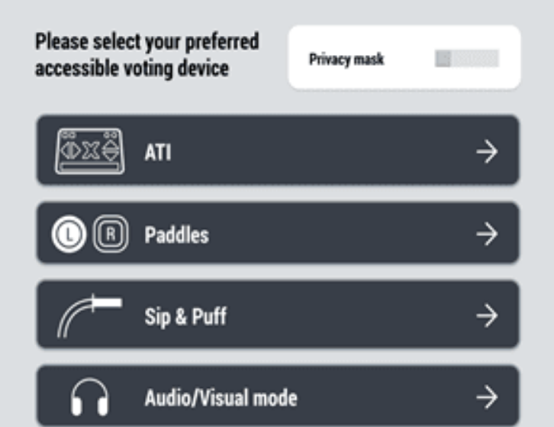
Adjusting the system: system controls
[ if there is a screen to set up the system controls, show it here]
The next step is to make sure the voter has the system set up so they can interact with it.
Our systems include:
[ The # button tactile keypad]
[ Paddles or dual switches ]
[ Sip-and-puff ]
[ Audio output with the screen on or off ]
Notes:
When a voter starts a voting session, the voter may also need to adjust preferences.
[Insert instructions for your specific voting machine on how to adjust it. Include whether this has to be done before starting the voting session.]

Slide 26
Help voters learn the buttons on the controller
If the voter is using the tactile controller, ask if they would like an orientation to the main features. [ You can also direct them to the tutorial in the system. ]
Focus on the buttons to navigate and mark the ballot. On our system:
  [ buttons to scroll within a contest ]
  [ button to select a candidate or option ]
  [ buttons to move from page to page ]
Describe buttons by shape and location, not just color
Show the controller and button layout here.
Notes:
If the voter is using the controller, ask “Would you like me to tell you what the controller buttons do?”
Some voting machines have controllers with a lot of buttons and features. Make sure to focus on the main navigational features of the controller, such as the ability to scroll and make their selection
Do not only use color to describe the buttons, such as “the yellow buttons will scroll and the blue button will make a selection.” Instead, use color, position, and shape together. “The yellow arrows that point up and down will scroll up and down your ballot. The yellow arrows to the left and right will move you to the previous and the next screens. The blue square in the center of the arrows will make your selection.”

Slide 27
Adjusting the system: screen display
Put a picture here of the system accessibility options for adjusting the screen and audio
Finally, there are screen display and audio options.
Help the voter make these adjustments before starting to vote, so that you can assist them without seeing their ballot.
Our systems include:
[ # of text sizes]
[ # of options for color contrast ]
[ Audio volume ]
[ Audio speed (or rate) ]
Notes:
Finally, make sure that the screen display makes it easy for the voter to see the screen, hear the audio, or both.
[Insert instructions for your specific voting machine on how to adjust it].

Slide 28
Follow the script so you don’t leave anything out.
Customize the script to include the features on your accessible voting system.
“This is the accessible voting system. You will use it to read and mark your ballot. Once you’re done, you’ll [print the ballot and take it to the scanner] [review and cast your ballot].
You can make the text larger and smaller or change the contrast. It also has [insert other features].
If you want to use the audio ballot, the headphones and controller are in front of you. You can change the volume and speech rate.
[Some screens have more than one contest on a page][Some contests have many candidates], so make sure that you scroll to the bottom of the page to see all the choices.
Do you have any questions?”
Notes:
When you take a voter to the accessible voting machine, it is helpful to have a short script for all voters that quickly explains how the machine works and what features are available.
Focus on aspects of the system that can be confusing, such as having more than one contest on a page.

Slide 29
Include important reminders about how to vote
Adjust this slide to be consistent with the script on the previous slide and to match your jurisdiction. Edit the speaker notes to match
[Voters may need to scroll to see all contests/choices on a page]
Voters can verify their choices before printing/casting their ballot
If the voter finds a mistake after they print their ballot, they can spoil the ballot.
When starting a voting session, let the voter know what features are available:
  “The voting machine can [read the ballot to you, make the text larger or smaller, etc]”
Let them know that headphones and a controller are available
  Offer them but do not place the headphones on the voter unless they ask
Remind them that they will mark their ballot on the accessible system, and [they must then print it and take it to the scanner to cast it] [the ballot is cast at the machine]
Notes:
This slide reinforces the information on the previous slide’s script.
It is important for voters to know:
[If using a BMD] Remind the voter that the voting machine does not cast their ballot. Inform them that they will use the machine to mark their ballot, and then their ballot will be printed, and they will then take it to the scanner.
[Some screens have multiple contests on a page (include if applicable)]
On some screens, voters may have to scroll to see all of the candidates. Make sure voters know they should scroll to the bottom of the screen.
When they have finished making their choices, they will be able to review their choices before [BMD: printing][DRE: casting] the ballot
If the voter finds a mistake on their ballot after they have printed it, they can spoil the ballot before they cast it and mark another one. They can mark up to three ballots, but only cast one.
Let the voter know which accessible features are available on the device:
“This machine can [read an audio ballot to you, make the text larger or smaller, change the contrast of the screen, other features]”
If the voter wants to use the audio ballot, offer them headphones. Do not place the headphones on the individual unless they ask you to
If the voter is going to use the controller instead of a touchscreen, give them the controller and ask if they want you to do a quick orientation of the buttons

Slide 30
How to assist voters:
While they are voting
"While I was voting the poll worker stepped back about 20 feet and waited until I was finished voting. "
Public comment from NIST Request for Information for E.O. 14019, Promoting Access to Voting

Slide 31
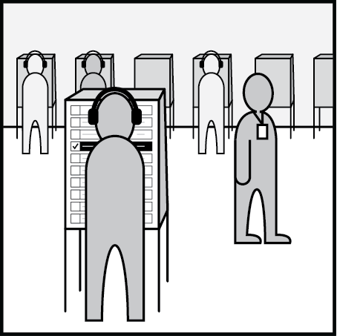
Be available to help, but don’t hover
If a voter asks for help while they are voting:
Some voters may need more time to be able to vote, so don’t rush them.
Do not speak over an audio ballot session.
Let the voter know a poll worker will be nearby but not looking at their ballot.
If you are going to remain very close by but you aren’t helping the voter, turn your back to the screen or make sure it is out of your sight line.
Try to answer their question without looking at the screen.
Notes:
Remember that when a voter is voting on a machine, they should have as much privacy as possible.
If you have started the voting session and the voter does not need help, step away but let them know that you will be nearby if they need assistance. Tell them how they can get your attention, such as waving a hand or raising their voice slightly.
If you are not assisting the voter but will be close by, stand somewhere where you can’t look at their ballot.
If the voter has asked you a question or is asking for help, try to help them without looking at the voting machine. If you have to look at the voting screen to be able to answer their question, step away as soon as you can so that they can continue to vote privately. If the voter is blind or has low vision, tell them when you are stepping away, for example, “I’m going to step away now to give you privacy to vote,” and then let them know how they can get your attention if they have more questions.

Slide 32
Let the voter know what you are doing
In addition to letting voters tell you what help they need, you can tell them what you will do to help them.
For example, if they need help while they are voting, you might say:
“I would need to look at the screen to answer your question. Once I’m done, I will move away to give you privacy so that you can continue voting. Is that okay?” If so, “Let me know when you are ready for me to look at the screen.”
Notes:
During the voting session, a voter may or may not need your help.
First, keep in mind that some voters need more time to vote. Make sure that you don’t rush a voter or show impatience.
If you think a voter needs assistance:
If a voter is using headphones and they look like they are in the middle of listening to the audio ballot, do not try to interrupt them. Instead, wait for a cue that they need help, such as taking off the headphones.
Again, always ask before offering assistance. Make sure that you approach them without looking at their ballot.
As much as possible, try to answer their questions without looking at their ballot. If you do need to look at the screen, first ask their permission. “I would need to look at the machine to answer your question. Once I’m done, I will move away to give you privacy so that you can continue voting. Is that okay?” If so, “let me know when you are ready for me to look at the screen.”

Slide 33
Troubleshooting during the voting session
Communicate directly with the voter:
Even if they have an assistant or interpreter
Explain what you are doing
Let them know if you are waiting for assistance or how long it may take
Troubleshoot the problem as much as possible
Let them know about any alternative options, but don’t pressure them to vote on a paper ballot if they want to use the accessible voting system
Notes:
If a voter is having a problem during the voting session, it is important to communicate clearly and directly with the voter while you try to troubleshoot the problem. Whether the problem is an issue with the voting machine, or the voter is having trouble with the voting process, be patient and communicative as you try to resolve the issue.
When troubleshooting a problem or assisting a voter, keep in mind:
Communicate directly to the voter, even if the voter has an assistant or is using an interpreter. Look at and speak to the voter. Don’t ask the helper and interpreter “does [voter] need help?” Ask the voter, “Do you need help?”
Explain what you are doing, especially if you have to work with the voting equipment. This is especially important for voters with blindness and low vision, who may not be able to see that you are helping them. For example, if you need to step away and look at the polling place manual, tell the voter, “I’m going to go look at the polling place manual so I can answer your question.”
Troubleshoot the problem as much as possible. If the voter is having difficulty voting, try your best to answer their questions and rephrase your answers, if necessary.
If there is a problem with the voting machine, troubleshoot the issue and keep the voter informed about what is being done and how long it may take to fix the issue.
You may let them know about any alternative options, such as voting on a paper ballot. However, do not pressure them into voting on a paper ballot instead of using the machine. Some voters may not be able to privately and independently mark a paper ballot, and voters have the right to use the accessible machine. They may choose to wait until the machine is ready to use.

Slide 34
How to assist voters:
While they are verifying and casting their ballot
“Once the paper print ballot is released from the machine, we should have an envelope immediately provided at the machine to avoid the poll worker or anyone else to "peek" and see our voting choices.”
Public comment from NIST Request for Information for E.O. 14019, Promoting Access to Voting

Slide 35
Helping voters verify and cast their ballot
Voters should verify their choices before [printing] [casting] the ballot.
Voters can spoil a ballot after printing it and have three tries.
Handling the printed ballot
Let the voter handle the ballot themselves unless they ask for help
If the voter needs help with handling the ballot, ask before taking it from them
[ Place the ballot in secrecy sleeve ]
Notes:
Voters will have the option to verify their choices before printing out/casting their ballot. When they have reached the last screen, they should be able to review their choices. Be prepared to help them with any questions, such as explaining messages about overvoting or undervoting, or questions on how to go back and change their choices.
If a voter has printed their ballot and they notice an error, let them know that they can “spoil” their ballot and try again. They have up to [three] tries to correctly mark the ballot before casting it.
When a voter is ready to print their ballot:
Let the voter handle their ballot themselves unless they ask for help.
If your polling place has privacy secrecy sleeves, offer the sleeve to the voter. Let them know that they can place the ballot in the sleeve to take it to the scanner.
If the voter has asked you to help them with printing the ballot and/or taking it to the scanner, make sure that you ask them before handling the ballot. “Your ballot has printed. May I pick it up now? We can go to the scanner.”
[If the voter can visually verify the ballot] “Would you like to check your votes before we go to the scanner?”
[If there is a post-printing read-back function] “Would you like to use the [name of function] to check the printed ballot?”
[If neither of the above] “Are you ready to take your ballot to the scanner? I have a secrecy sleeve for you while we walk over there.”

Slide 36
Helping voters get to the scanner
Remove this slide if your jurisdiction does not use a scanner or where voters cast their ballot at the voting booth.
Ask the voter if they would like assistance getting to the scanner
For voters who are blind or have low vision:
Tell the voter where the scanner is located and offer to guide them
If they want you to guide them, do not grab them. Offer them your elbow so they can walk with you to the scanner
If they have a service animal, stand on the opposite side of the voter from the animal
Notes:
Instructions: Delete if your polling place uses a DRE system that does not include a paper ballot.
Once the voter has printed their ballot, offer them assistance with getting to the scanner.
If the voter is blind or has low vision: “Would you like me to guide you to the scanner?”
Tell them where the scanner is, for example, “the scanner is straight ahead of you, about 20 feet away.”
If the voter would like you to guide them, do not grab them. Offer them your elbow to take, and then walk beside them to the scanner.
If the voter has a service animal, stand on the opposite side of the voter from the service animal.

Slide 37
Helping voters scan their ballot
Remove this slide if your jurisdiction does not use a scanner.
Tell voters who are blind or low-vision where and how to insert the ballot
Tap the scanner where they will insert the ballot for an audio cue
If using privacy sleeves, let them know they can feed the ballot through the sleeve
If there is an error message, maintain ballot privacy while troubleshooting
Notes:
At the scanner:
Just like with printing the ballot and taking it to the scanner, do not try to take the ballot from the voter to scan it unless they ask you to do so.
For blind and low-vision voters: tell them where to insert the ballot and how to insert the ballot. For example, “You can insert the ballot in the slot in front of you. Make sure the notch on the ballot is in the top right corner.”
As an audio cue, tap the area of the scanner where they will insert their ballot
If using privacy sleeves, let the voter know they can use the secrecy sleeve to hide their ballot while they scan it, or feed the ballot through the sleeve.
If there is an error message, make sure not to crowd around the voter when troubleshooting it. If their ballot is not yet scanned, make sure not to look at their ballot or offer them a way to keep it private, such as a secrecy sleeve.

Slide 38
When they are done
Offer the voter their “I voted” sticker
Don’t try to put the sticker on the voter, let them ask if they need help
For voters with blindness or low vision, let them know how the sticker is oriented so they don’t put it on upside down
Ask them if they need directions to the polling place exit
Notes:
You can help a voter with their sticker verbally, by saying “Here is your “I voted” sticker. The edge closest to you is the bottom of the sticker.”

Slide 39
Summary and resources
"Having the accessible voting machine already set up by the poll workers familiar with its set up and operation speeds up the process and makes it less unequal in experience for disabled voters."
Public comment from NIST Request for Information for E.O. 14019, Promoting Access to Voting

Slide 40
Summary: Do
Offer every voter the option to use the accessible voting system
Ask if a voter needs help
If the voter is listening to the audio ballot, wait until they signal you that they are ready before you speak to them
Give voters time to vote. Everyone votes at a different pace
Offer a voter headphones if they are voting by audio ballot
[BMDs] Offer to help them navigate to the scanner or ballot box
Troubleshoot a voter’s problem as much as possible, so they can vote privately and independently

Slide 41
Summary: Don’t
Ask someone about what disability they have
Assume a voter needs help
Speak over a voter’s audio session
Rush a voter if you think they are taking too long
Place headphones on a voter unless they ask you to
Take a voter’s ballot to the scanner unless they ask you to
Try to discourage someone from using the accessible voting system if they’re having a problem

Slide 42
Your Election Day Resources
Use this slide to review
Procedures and forms
Job aids for the accessible voting system feature
Any other information in the poll workers’ manual
ASL interpreters if available remotely
Who to contact if you need help troubleshooting a problem

