Slide 1
#trustedinfo2020
<election website>
<email>
<phone number>
<Election date and type>
<County Board of Elections>

Slide 2
We’re here to help!
Have questions?
Visit our vote from home FAQ at:
<link>
If your ballot was lost, you never got it or you made a mistake, contact us.
We can track your ballot and/or cancel the first ballot. We can then send you a new one.
Read all instructions.
Be sure you voted the whole ballot.
Sign the outside of the envelope with your official signature.
Return your ballot early by:
mailing it a week before Election Day
dropping it off at your local election office before 8:00 pm on Election Day.
Sign your envelope and return
your ballot early.

Slide 3
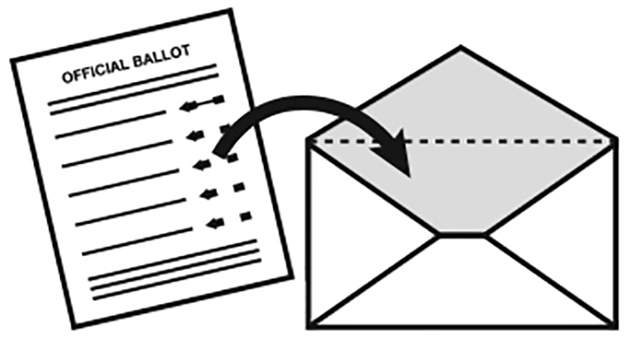
All registered voters can vote from home before Election Day.
Vote from home
Before the election, download the request form to get your ballot sent in the mail.
We’ll send your ballot to the mailing address you give us.
Mark your vote following the instructions on the ballot.
Return your ballot by mail, bring it to the election office, or drop it at your polling place on Election Day.
You can still vote in person.
If you prefer to vote in person, you still can. Bring your mail ballot with you.

Slide 4
Do things early! Help us out by submitting things before the deadline.
<October 30 by 5:00 p.m.>
Register to vote, or update your address.
Update your voter registration address every time you move.
<Month day time>
Request that we mail your ballot.
<Month day time>
Send your ballot early!
Return your ballot early enough to make it to the election office by election day.
<Month day time>
Election Day – polls open 6:00 a.m. to 7:00 p.m.

Slide 5
Yes. We take many precautions to secure your vote.
We verify every single cast ballot.
The signature on the envelope that you use to send us your ballot must match the signature we have on file in your voter registration record.
If it doesn’t match, we contact you to find out what happened.
How do I know if my ballot gets counted?
We track every voter’s ballot. This means you can check when the election office receives your ballot AND when your vote gets counted.
Signing someone else’s envelope is a felony.
This is very rare, but can happen. If convicted, you can face up to 5 years in prison.
Want to know more? Take the virtual tour of our vote from home process at <link>.

Slide 6
Request a ballot
Get the request ballot form <online> at: <link>
Get your ballot
We mail ballots <xx> days before the election.
a
Mark your ballot
Just like you would in the polling place.
Sign and seal your envelope
Return your envelope:
in the mail
by dropbox
at the election office
at your precinct on election day

Slide 7
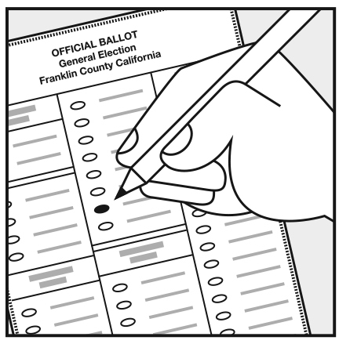
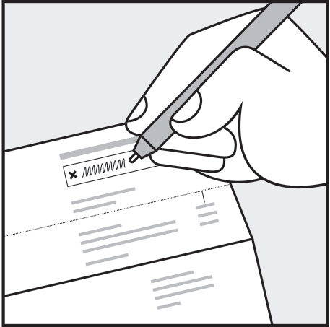
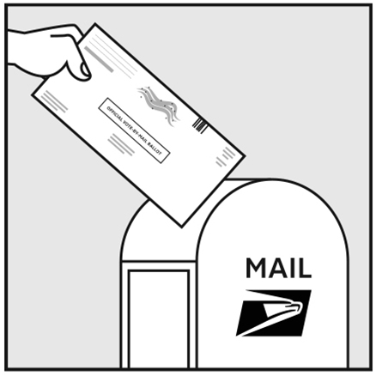
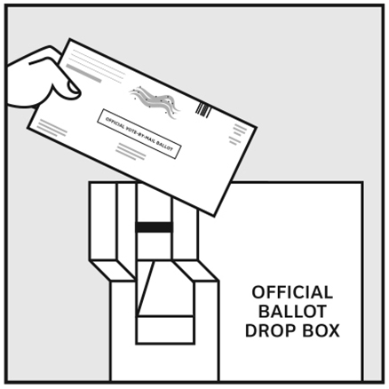
To vote on a paper ballot
Make your selection by filling in the oval next to your choice(s).
Put your ballot in the return envelope.
Sign the envelope.
You have 3 options to return your ballot
By mail
By dropbox
At your polling place
Want to know more about your how to return your ballot? Visit <link>.

Slide 8
An assistant can help you vote from home
Your assistant can show you how to mark the ballot so you can vote as you intend.
An assistant CAN NOT mark the ballot for you.
Both you and your assistant must sign the return envelope. If you are unable to sign your name, use the same mark or signature stamp that we have on file.
You can vote from home using a remote accessible option
Vote from home using your own devices. Print your ballot and return it in your ballot envelope.
You can vote in person
You can always vote at your polling place. Look up your polling place at <link>

Slide 9
The < election type> is an all mail election. We will mail every registered voter their ballot <##> days before the election.
Vote from home
We’ll send your ballot to the mailing address we have on file.
Mark your vote following the instructions on the ballot.
Return your ballot by mail, drop it in a drop box, or bring it to your polling place on Election Day.
You can still vote in person.
If you prefer to vote in person, you still can. Bring your mail ballot with you.

Slide 10
Get your ballot
We mail ballots <xx> days before the election.
a
Mark your ballot
Just like you would in the polling place.
Sign and seal your envelope
Return your envelope:
in the mail
by dropbox
at the election office
at your precinct on election day

