Slide 1
Sample Voter Guide Inserts
Vote at Home Envelope Insert Design
Review this presentation for examples on how to design inserts.
Edit the templates to make your own insert for your jurisdiction(s).
Print the insert on 8.5x11letter-sized paper.

Slide 2
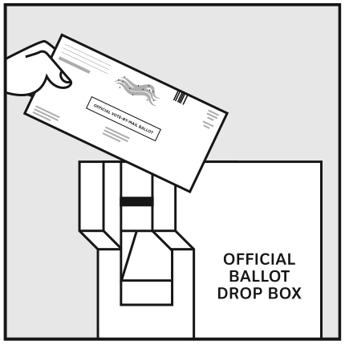
How to vote
General Election
Tuesday, November 6, 2018
Deadlines
You must postmark your ballot inside of your envelope by Election Day, November 6, 2018.
If you do not, bring your ballot and envelope to a drop box or vote center by 8pm on election day.
You have 3 options to return your ballot.
Drop Box
You can drop off your ballot at the 25 secure drop boxes located around the county – no postage required
Need help? Get in touch!
Vote by Mail
Mail your ballot so that it is postmarked by Election Day, November 6, 2018 Put 78¢ postage on the envelope
Your County Elections Office 4321 Franklin Ave
Franklin, HN 99999-1234
www.yourcounty.gov/elections
elections@yourcounty.gov
111-222-3333
Fax: 111-222-6666
Vote Center
You can go to any vote center in the county. 5 Vote Centers will be open for 11 days in a row and 20 will be open for 4 days before Election Day, including the weekend.
Find the Vote Center or Drop Box nearest you

Slide 3
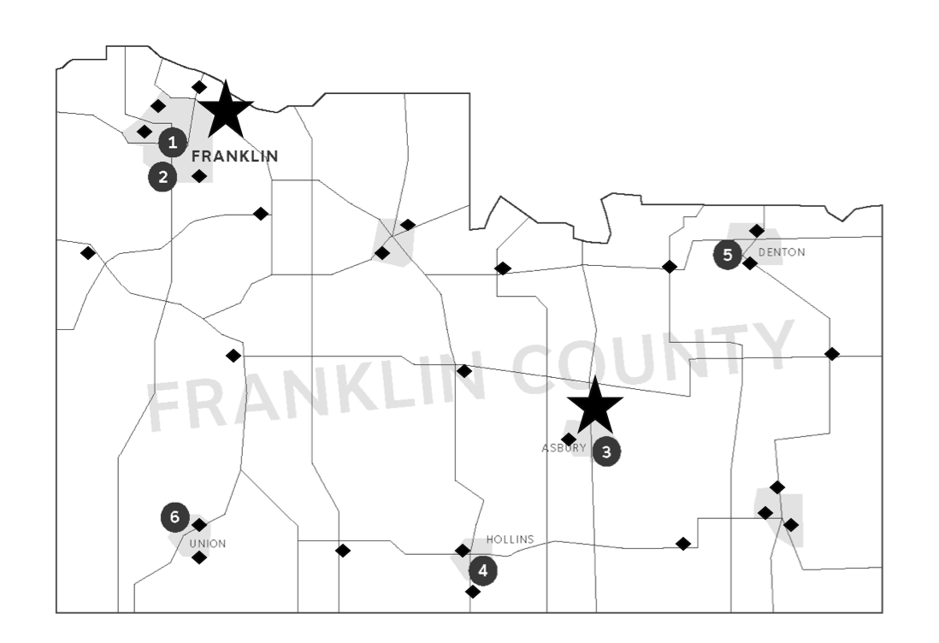
Mark, seal, and sign your ballot
50 ways to return your ballot
1. Mark your ballot
Follow the directions on the ballot.
2. Seal your ballot
Check that you have the Return Envelope with your name on it.
Put your ballot into the envelope. Only 1 ballot in each envelope.
Seal the envelope.
3. Sign the envelope in front of witness.
Ask someone to observe you sign your envelope.
Date and sign your name on the back of the envelope in ink.
Print your name and voter registration address.
Have your witness sign and date the envelope.
Made a mistake?
If you make a mistake you can get a replacement ballot.
Call 222-555-1212 before Election Day
or go to any Vote Center in the County.
It’s your choice!
You can return your ballot at any official drop box, vote center, by mail, or at the Elections Office.
To find the Vote Center or Drop Box nearest you www.yourcounty.gov/wheretovote
1
Drop Boxes
There are 25 secure and locked drop boxes around the county open 24 hours a day.
Election Offices
Open 8am - 5pm
Monday - Friday
Vote Centers
20 vote centers are open November 4 – 7
7am – 8pm
5 are open from October 28 through Election Day, November 7

Slide 4
How to vote
General Election
Tuesday, November 6, 2018
Deadlines
You must postmark your ballot inside of your envelope by Election Day, November 6, 2018.
If you do not, bring your ballot and envelope to our election office by 8pm on election day.
You have 2 options to return your ballot.
Vote by Mail
Mail your ballot so that it is postmarked by Election Day, November 6, 2018 Put 78¢ postage on the envelope
Need help? Get in touch!
In person
You can drop your ballot of at our
Election Office. The election office is open:
9:00am – 5:00pm
Monday – Friday
Visit us at:
4321 Franklin Ave
Franklin, HN 99999-1234
Your County Elections Office 4321 Franklin Ave Franklin, HN 99999-1234
www.yourcounty.gov/elections
elections@yourcounty.gov
111-222-3333
Fax: 111-222-6666
Know your voting rights

Slide 5
Mark, seal, and sign your ballot
Know your rights
1. Mark your ballot
Follow the directions on the ballot.
2. Seal your ballot
Check that you have the Return Envelope with your name on it.
Put your ballot into the envelope. Only 1 ballot in each envelope.
Seal the envelope.
3. Sign the envelope in front of a witness.
Ask someone to observe you sign your envelope.
Date and sign your name on the back of the envelope in ink.
Print your name and voter registration address.
Have your witness sign and date the envelope.
Made a mistake?
If you make a mistake you can get a replacement ballot.
Call 555-555-1212 before Election Day
or visit our Election Office
You cannot be denied the right to vote if you are legally qualified to do so.
You have the right to:
Vote if you have been registered at your current address at least 22 days before Election Day.
Ask any election officer for help.
Be shown how to mark and cast your ballot.
Ask for a new ballot if you want to change your vote before you cast it.
A provisional ballot if you have no photo ID with you or your name doesn’t appear on the voter list and you believe it should.
Bring your small child into the voting booth.
Vote if you are in line by 7:00pm when the polls close.

