Slide 1
Analysis of ballots US Senate contest California 2016 Primary
Nancy Frishberg
Whitney Quesenbery
Center for Civic Design
@civicdesign | civicdesign.org
September 1, 2016

Slide 2
About this election contest
This contest is part of the California Top-Two Primary.
Each voter gets one vote.
There were 34 candidates (plus a write-in).
The two candidates with the most votes go on to the General Election.
The required ballot order is: President, US Senate, US Representative, state and local offices

Slide 3
Natural experiment
There were 58 different ballot layouts
Election Code sets ballot order and requires specific instructions.
Some design decisions are constrained by the equipment and voting system.
Remaining design choices were up to the counties.
Which worked best to capture voter intent (had the fewest over-votes)?

Slide 4
Design decisions we examined
1 column, 2 columns or more?
How was this contest distinguished from others?
Title of contest across all columns? Shading?
Borders inside or outside the Senate columns?
How were the instructions shown?
Within the same column? In a preceding one?
How was the “Vote for One” message shown?
Was this message repeated for 2nd column?
Was the NPP ballot the same or not?
Were there instructions in the voter guide?

Slide 5
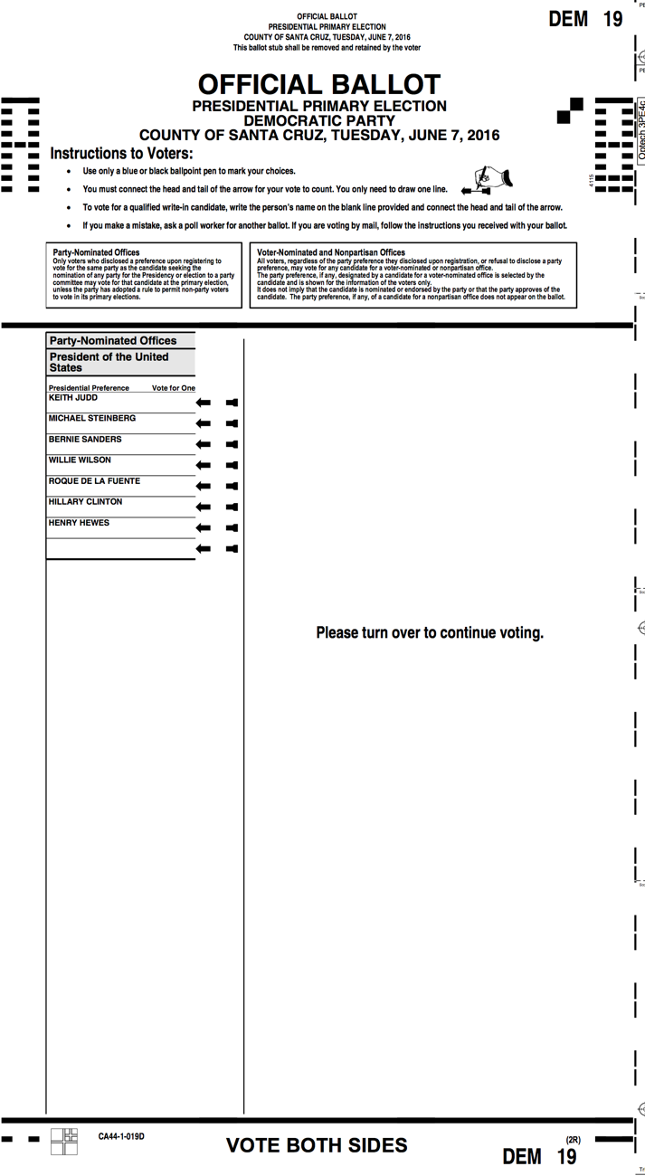
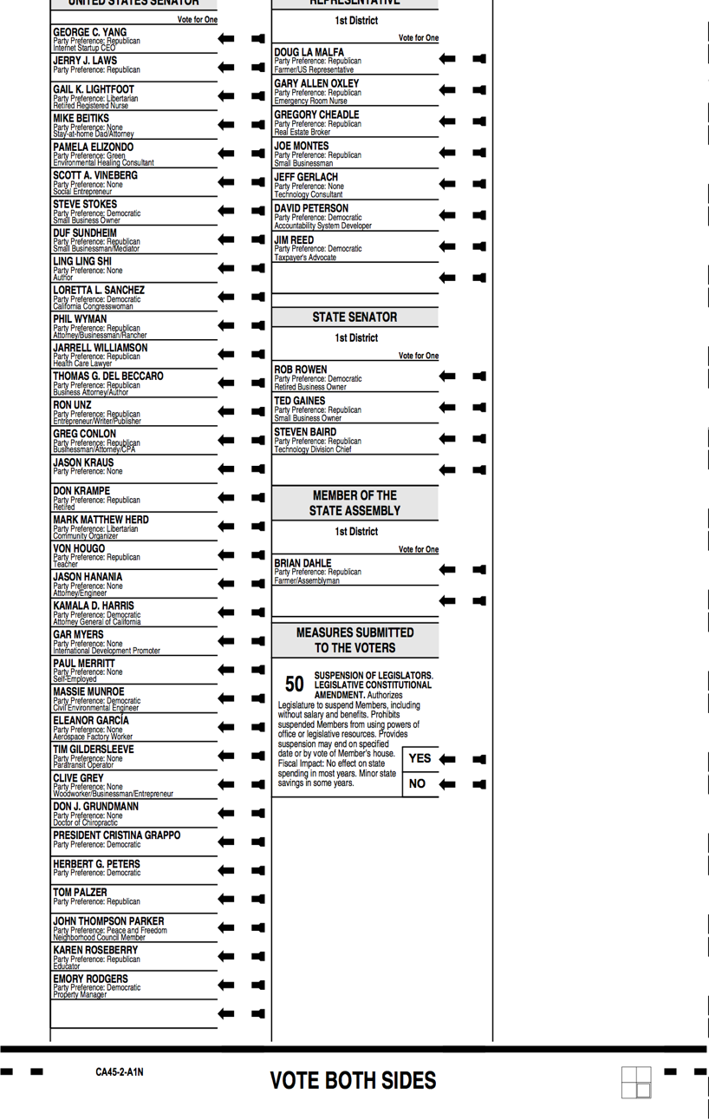
Key design elements of ballot
④ Contest titles
⑤ Vote for one
⑥ Senate
candidates in
single column
② Instructions for
Voters
① Contest
order
③ Turn page over
⑦ Number of
columns and
where other
contests appear
Front
Back
Notes:
1. Contests in order prescribed by law (President; Congress (US Senate, US Representative); state offices; local offices, non-partisan offices; state measures, then local measures)
2. Instructions at top of first page: Party-nominated offices then Voter-nominated offices
3. Instruction to turn over page to continue voting
4. Shaded titles for contest
5. Vote for one, right-justified close to area to be marked, an arrow with only head and tail.
6. Candidate names fit into one column
7. How many columns? Where are other contests, relative to US Senate?

Slide 6
How was the US Senate contest displayed?
1 column
2 columns
3 columns
Across a page or card boundary
Additional features
What else is in the context of the US Senate race? On the same page? In the same column?

Slide 7
One column layouts
25 counties fit the US Senate contest into 1 column

Slide 8
The type of voting system determines number of columns
Research shows that putting all names for one contest in a single column avoids some errors.
Most optical scan ballots use three columns
One system uses
3 equal columns per face
Also adapts to 2 columns as 1 narrow, 1 double-width
One system uses
2 (wider, equal-sized) columns per face
Notes:
One column layouts:
1 of 3 columns: 7 counties
Double-width column: 7 counties
1 of 2 equal columns: 11 counties

Slide 9
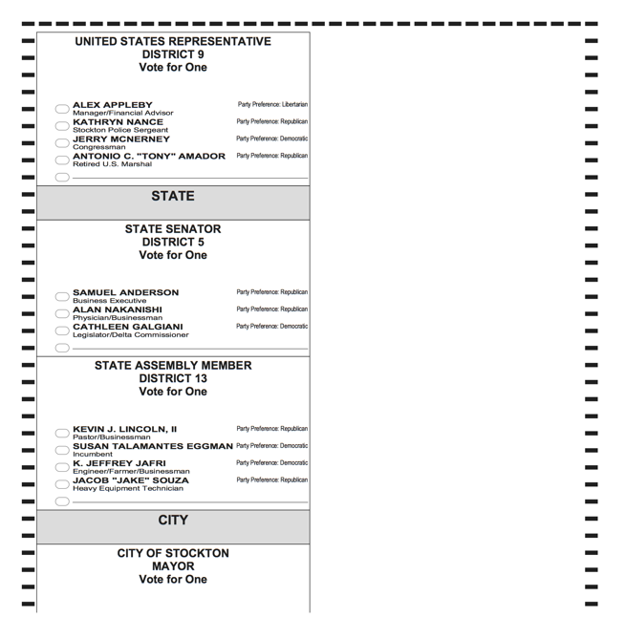
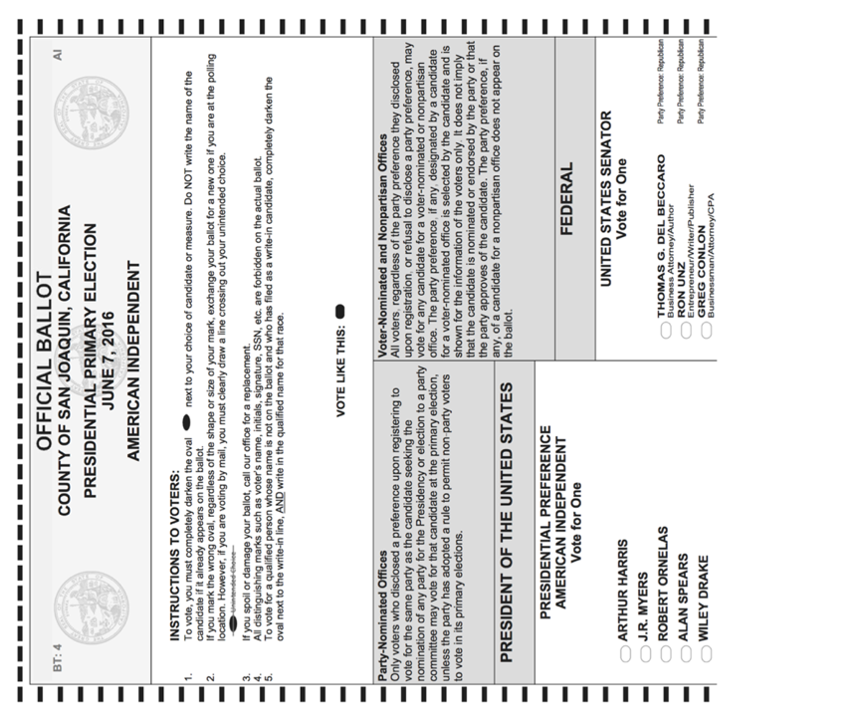
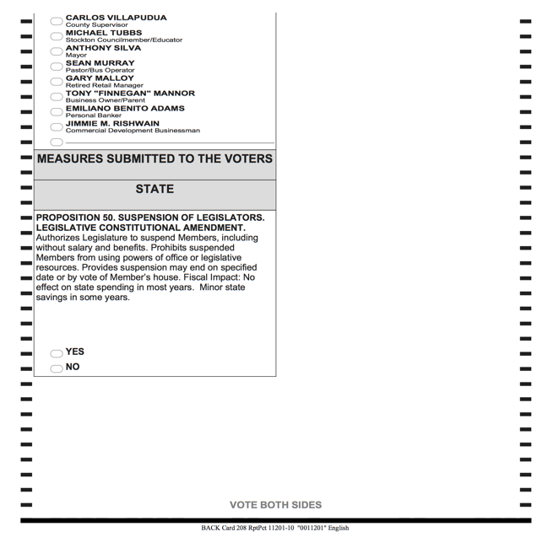
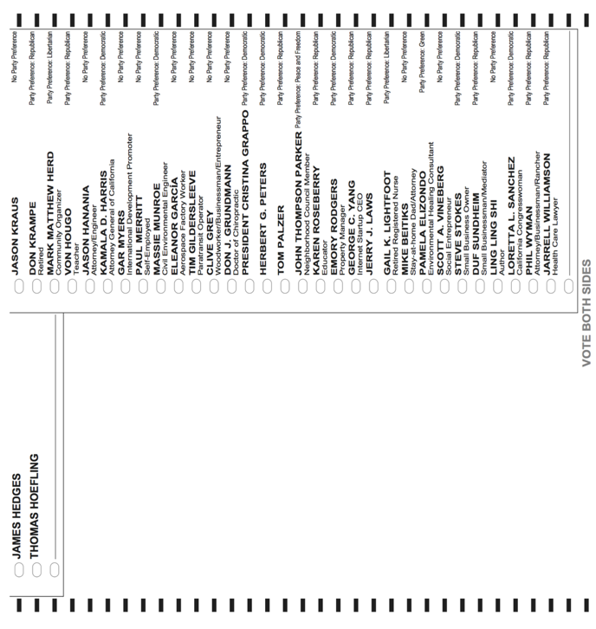
Senate on the front
Front
2 wider columns
All voting instructions
Column 1: President or blank (NPP)
Column 2: Senate in one column
Back (reduced size)
Remainder of contests
Used by: 16 counties
Shown: San Joaquin
Front
Back

Slide 10
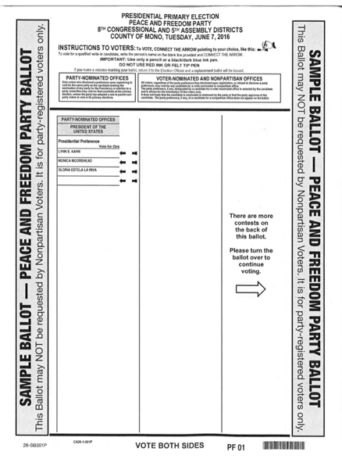
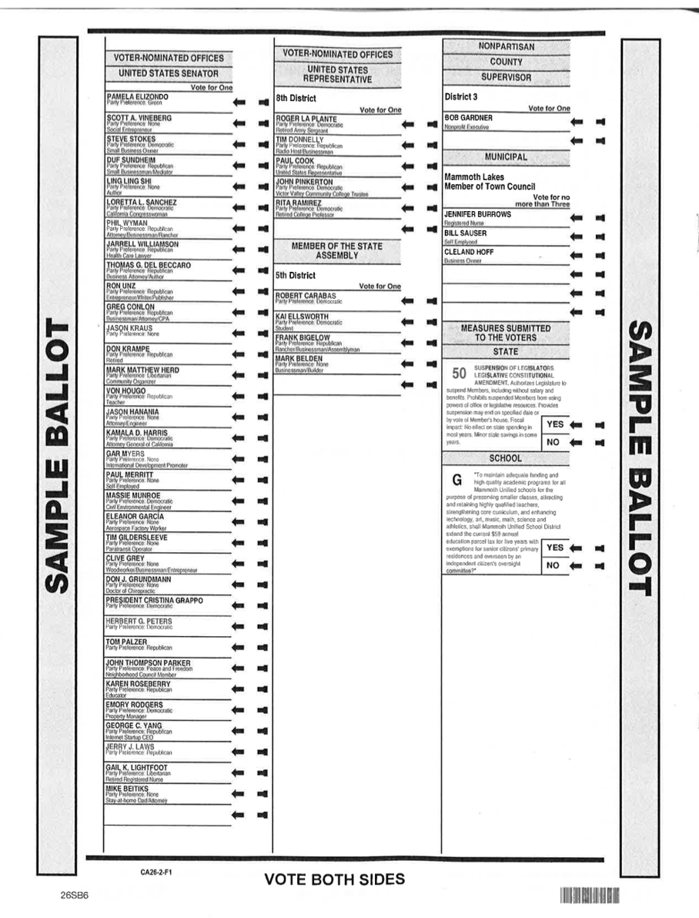
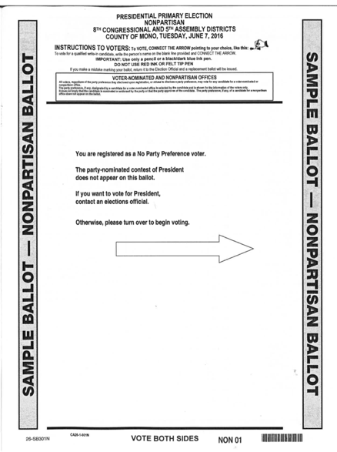
Senate on the back
Front (reduced size)
Voting instructions
3 column format
Column 1: President or blank (NPP)
Large message to turn the ballot over
Back
Column 1: Senate
Columns 2 & 3: Other contests
Used by: 9 counties
Shown: Mono
Front
Back

Slide 11
Two column layouts
24 counties used 2 columns to display choices for US Senate

Slide 12
Two-column layout dilemma
Our research confirms the Better Ballot work from the Brennan Center
A contest invites errors where candidate names continue across a column or page boundary
Given that, which choice is better?
Make the columns as even as possible in length, for a unified look, or
Fill Column 1 (to indicate a long list), then add the rest in Column 2

Slide 13
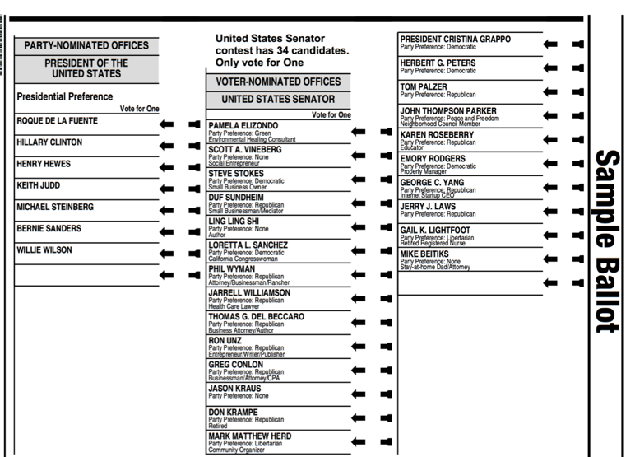
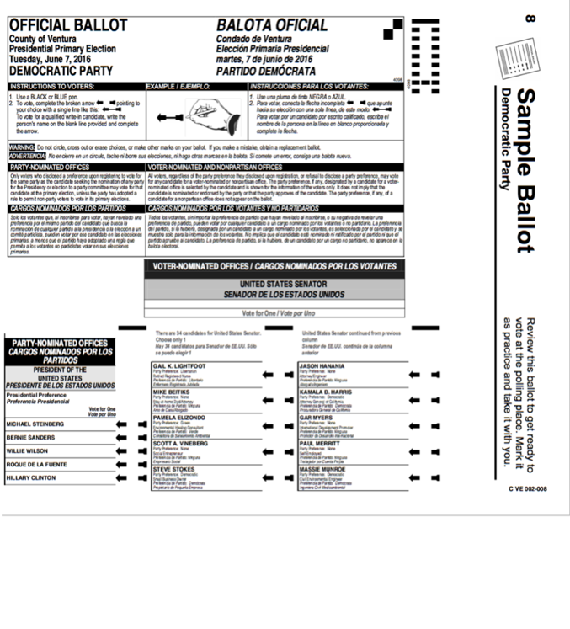
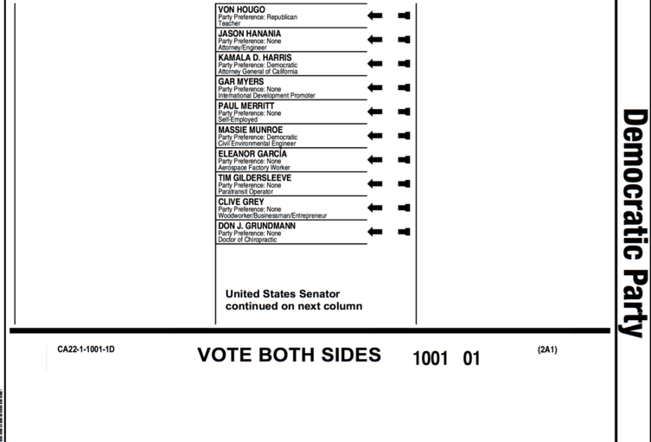
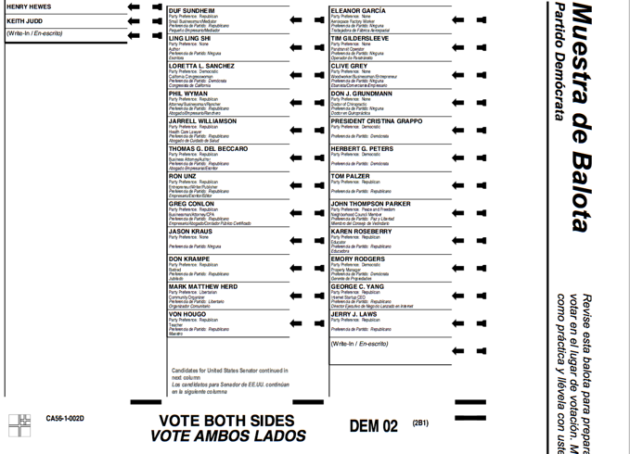
Senate on the front
3 column format
Column 1: President
Columns 2 & 3: Senate
Columns: Even or uneven
Used in: 24 counties
Shown: Ventura (even), Mariposa (uneven)
Even columns
Uneven columns

Slide 14
Three column layout
3 counties use 3 columns

Slide 15
Three-column layout
Three-column layouts have similar challenges to two-column treatments.
What design choices do election officials have when choosing to use 3 columns?
Make instructions/contest titles span width or one column only
Add boundaries around or remove boundaries within the area with 34 names
Add instructional text as headings or footers

Slide 16
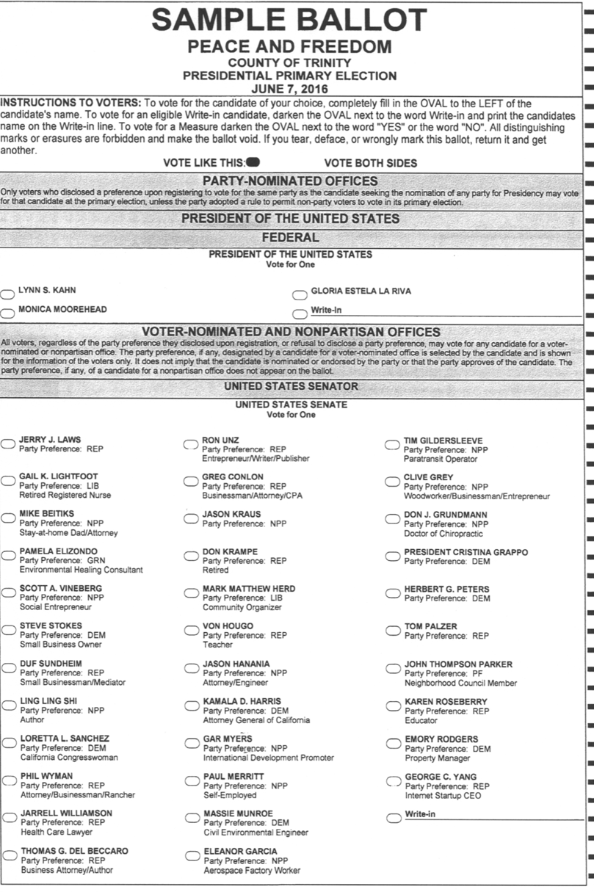
Three-column layout
US Senate contest fills full page, spans 3 columns
Instructions and contest titles span all 3 columns to page edge
No columnar (vertical) lines within the contest
Used by: 3 counties
Shown: Trinity

Slide 17
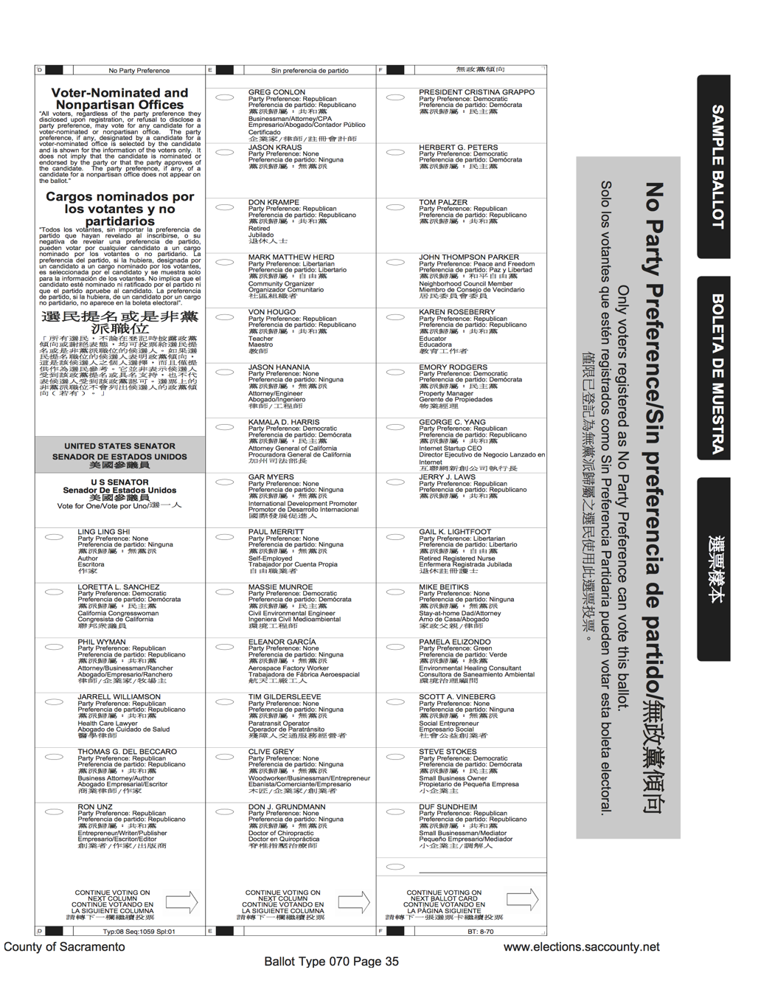
Three-column layout
Senate contest fills whole page in 3 columns
Instructions, contest titles placed in column 1 only
Columnar (vertical) lines separate columns
“Continue voting” message in footer, not specific to US Senate contest
Shown: Sacramento

Slide 18
Multi-card system
6 counties use a multi-card system

Slide 19
Shape of the ballot
The Mark-a-Vote system has a different form factor for ballot cards from those already described
These counties faced the challenge of laying out the Senate race, knowing 2 sides of a card or more are needed.
Los Angeles uses the Ink A Vote system, similarly configured.
Advance testing allowed Los Angeles to test and revise multiple times before committing to a design.
One thing learned during testing was that by removing the contest title on the second card it signaled ”continuation of list,” and prevented some errors.

Slide 20
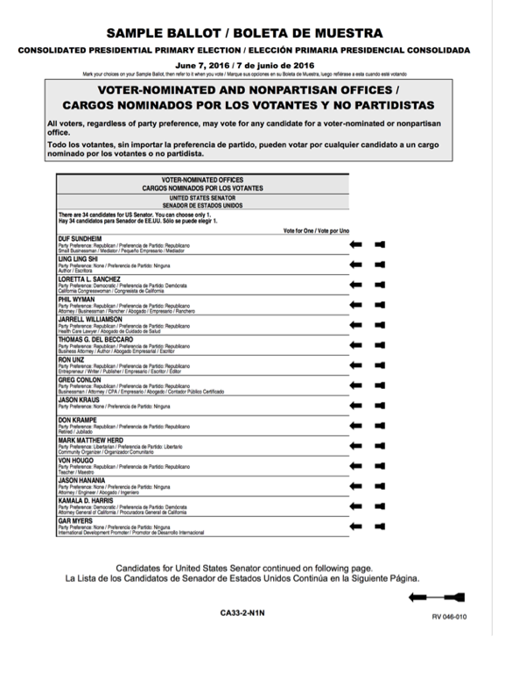
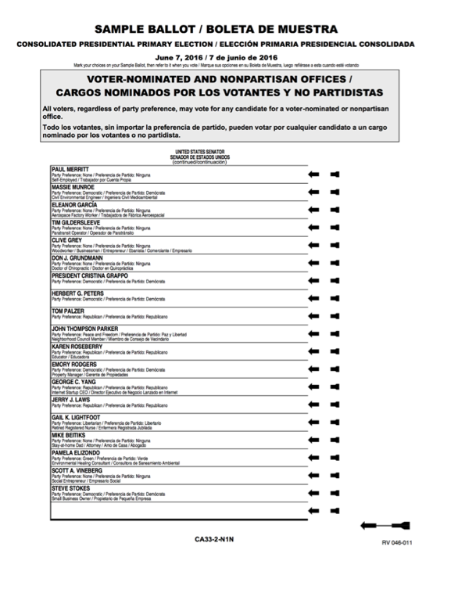
Two ballot cards
Shows 2 cards
Uses messages at bottom of Card B (front) and top of Card B (back)
Single column presentation crosses the page boundary
Used by: 5 counties
Shown: Madera
Card B front
Card B back

Slide 21
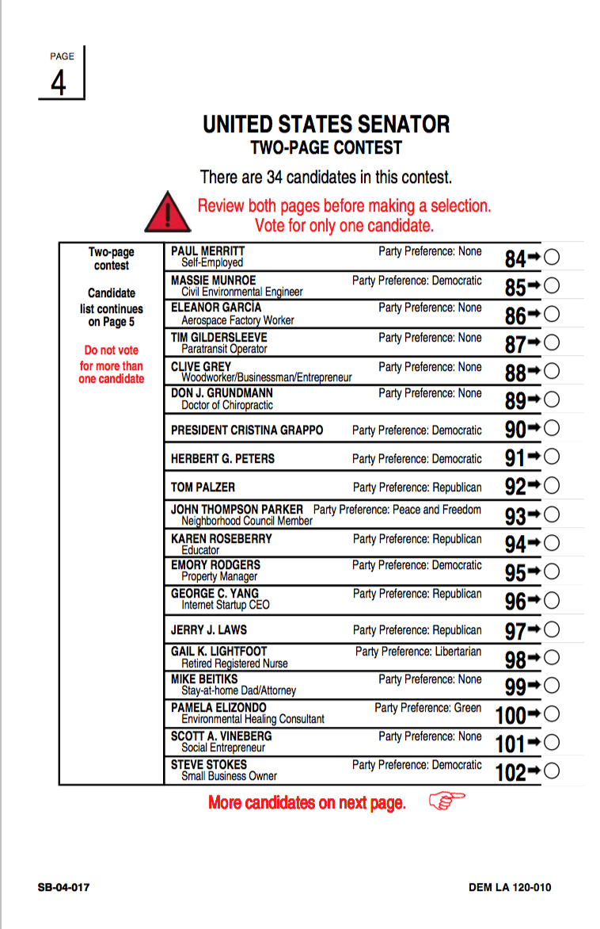
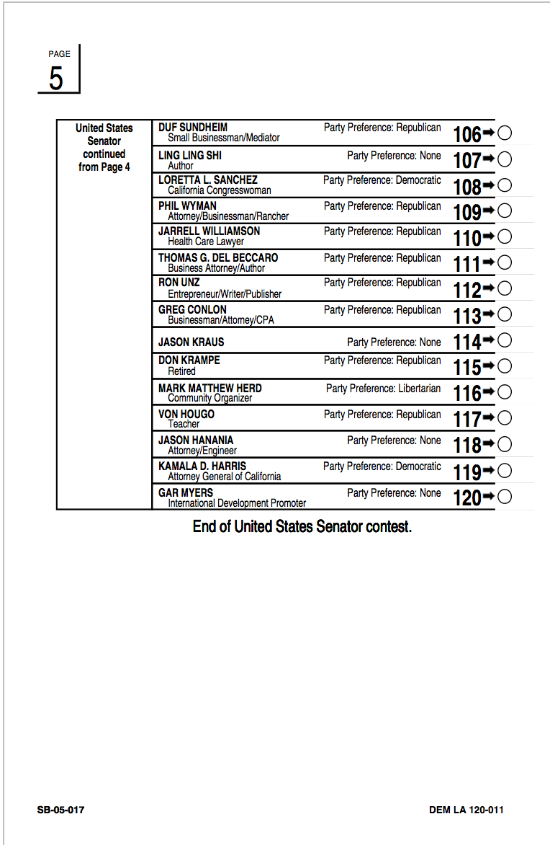
Two ballot cards
Shows 2 cards
Uses red text to focus on key messaging
Does not repeat the contest title on Card 5
Bottom of columns “More candidates on next page” and “End of contest"
Single column format continues across the card boundary
Used by: 1 county
Shown: Los Angeles
Card 4
Card 5

Slide 22
NPP ballot is different from Party ballot
19 counties laid out the NPP ballot differently
(We do not have samples of the NPP ballot for 8 counties)

Slide 23
No Party Preference (NPP) ballots did not include the Presidential contest
3 parties allowed “cross over” voting for NPP voters
NPP voters had to request a party ballot
No voter would see the comparison between one layout and the other
Some counties filled the blank space where the Presidential race would have appeared by moving the Senate race into the first column

Slide 24
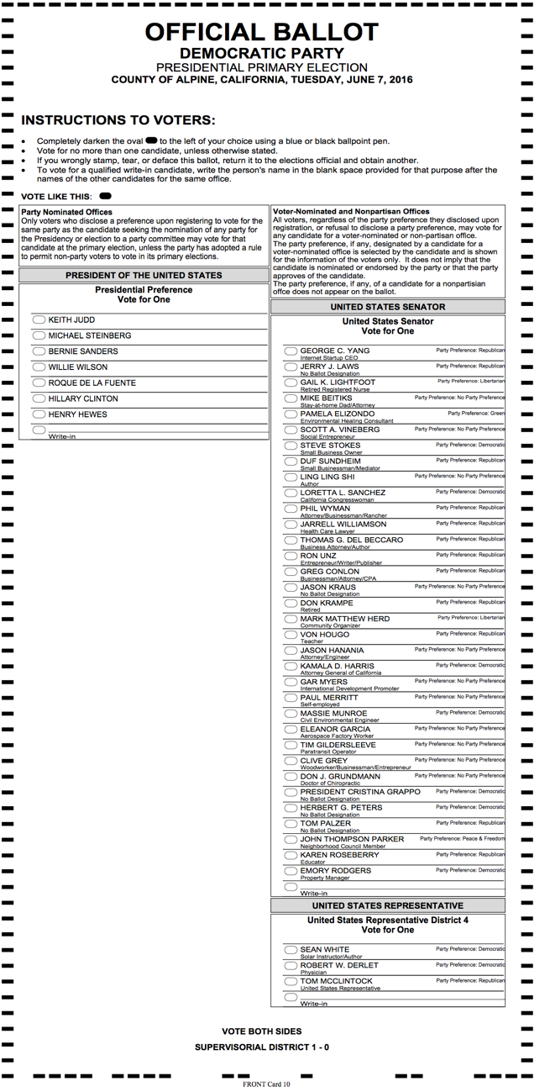
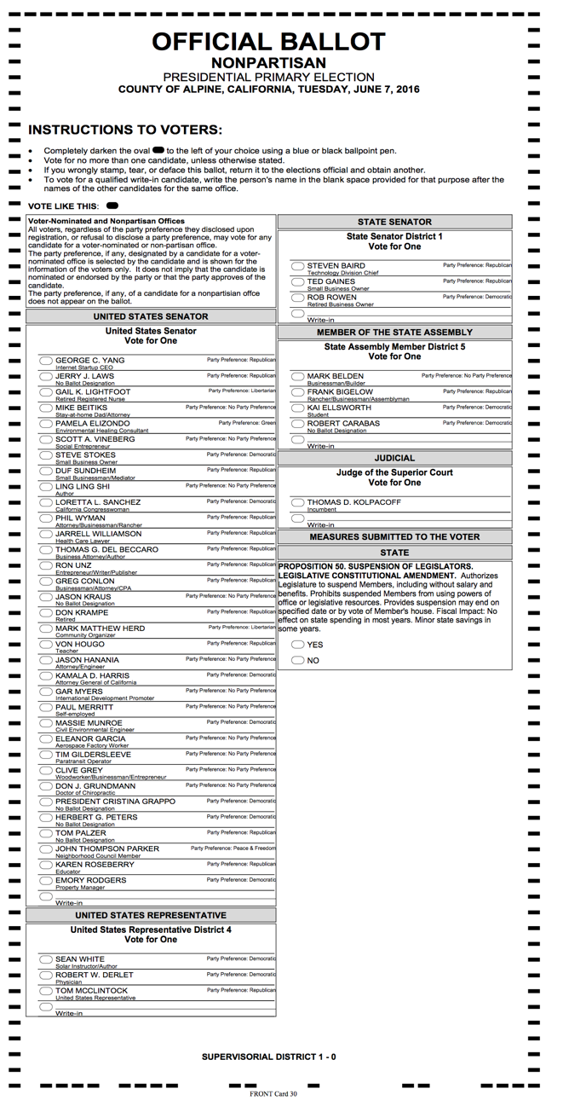
Party ballot layout different from NPP ballot
2 column format
Party ballot (left)
Front
President in left column
Senate & US Representative in right column
Back (not shown)
Remaining contests
NPP ballot (right)
Front
Senate & US Representative in left column
Remaining contests in right column
Back (not shown)
Remaining measures (or blank)
Used in: 6 counties
Shown: Alpine
Party ballot
No Party Preference ballot

Slide 25
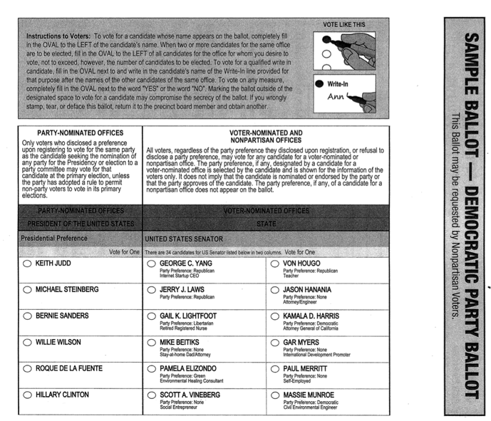
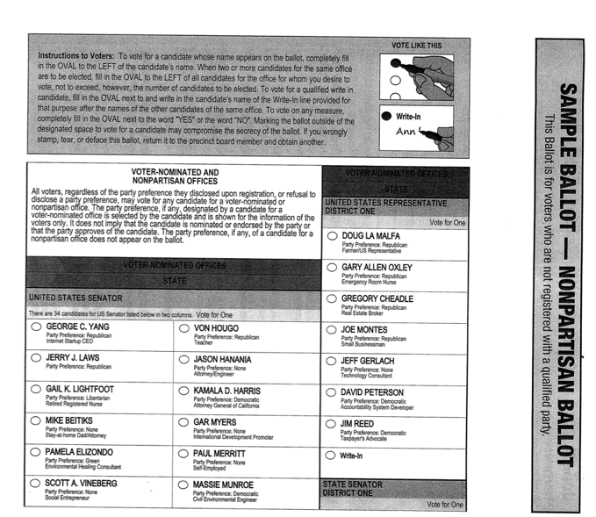
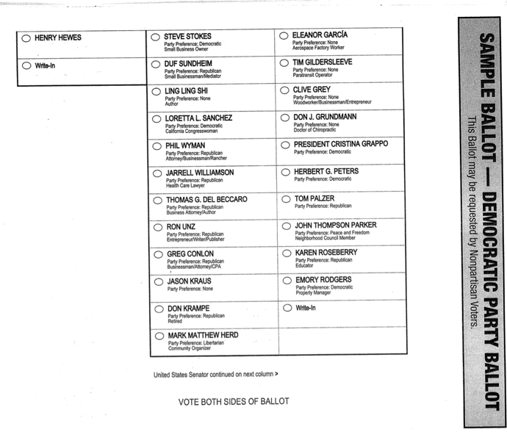
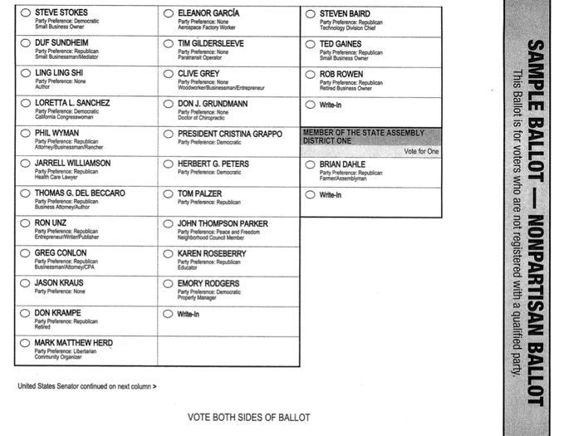
Party ballot different from NPP ballot
3-column format
Party ballot (left)
Front
President in left column
Senate in middle & right columns
Back (not shown)
Remaining contests
NPP ballot (right)
Front
Senate in left and middle columns
Other contests in right column
Back (not shown)
Remaining contests (or blank)
Used in: 9 counties
Shown: Siskiyou
Party ballot
No Party Preference ballot

Slide 26
Context around US Senate contest
Other races on same side of page, or in same column

Slide 27
How does the US Senate context fit into the ballot layout?
President and US Senate races appear on same side of page together, or Senate moves to the back.
US Representative follows Senate, occasionally in same column, or on the next page/side.
When Senate moves to back (leaving President on front), the rest of the contests may fit on the back, keeping the ballot to one card

Slide 28
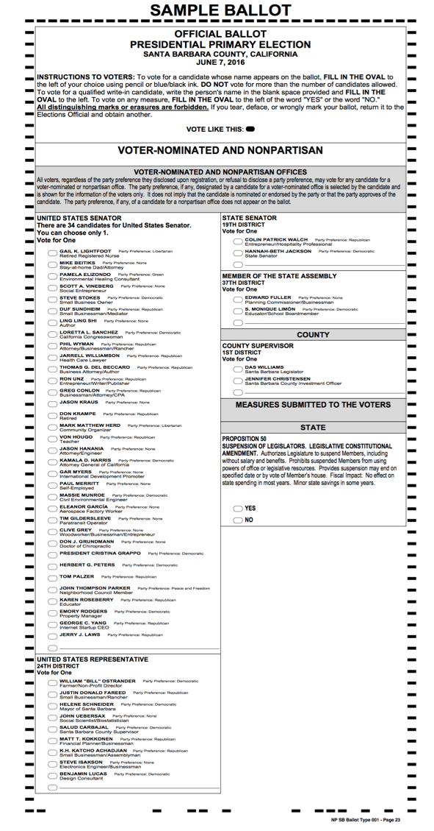
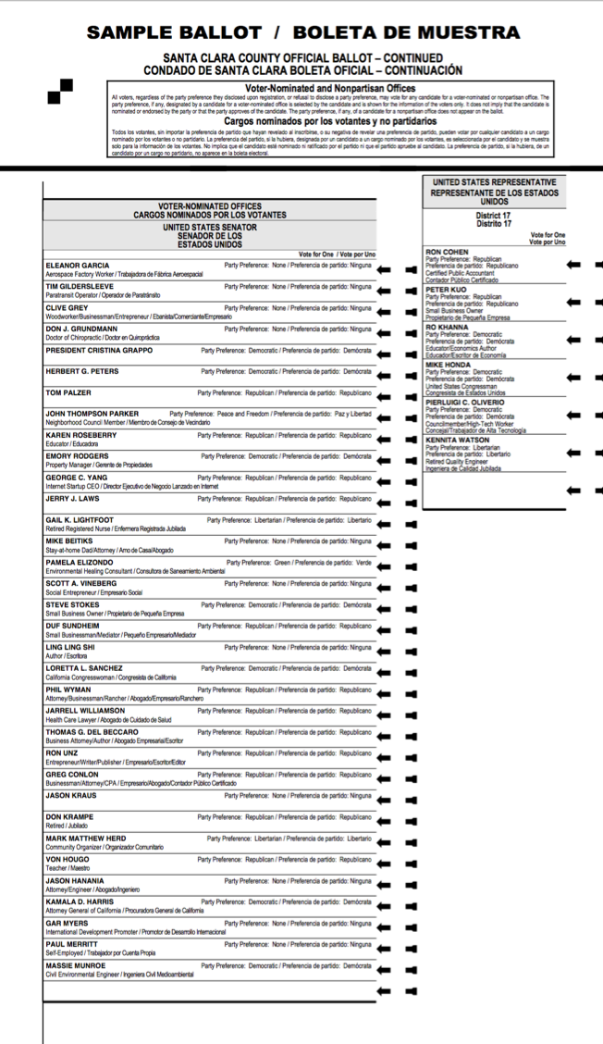
Context of US Senate race
US Representative race appears below in same column, or
US Representative race appears in following column
Shown: Santa Barbara
Santa Clara
US Representative shares
column with US Senate race
US Representative follows
US Senate race

Slide 29
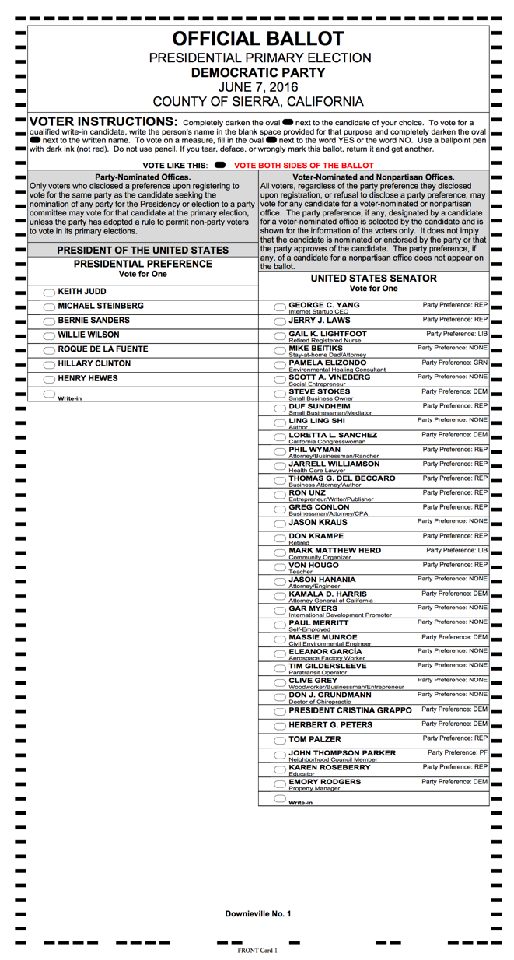
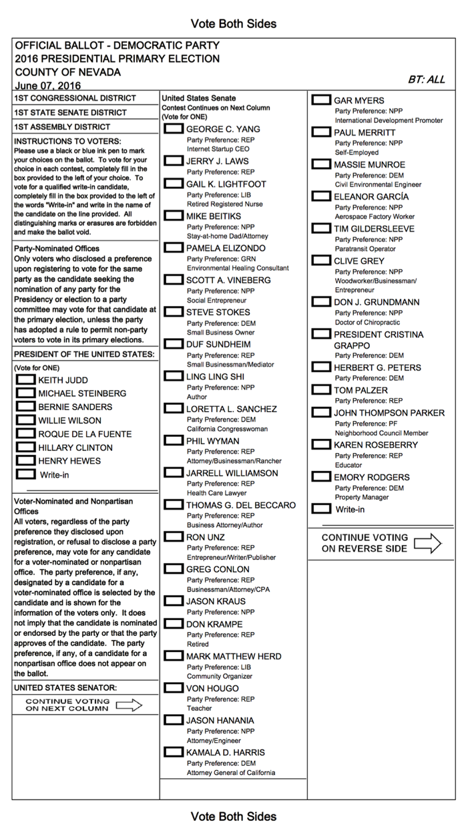
Context of US Senate race
President appears in preceding column
Shown: Sierra
Nevada

Slide 30
Creating boundaries for the contest
Counties found many ways to indicate US Senate is a single race

Slide 31
How is the US Senate contest separated from other contests?
Counties found ways to visually distinguish this contest from others
A single column solely for US Senate
When listed in 2 or more columns
Make the instructions and/or contest title span all columns
Add a heading for each column
Add a footer for each column
Use arrows to enclose columns
Remove lines between columns
Notes:
Of 27 counties that have 2 or 3 columns for the US Senate race, 11 have instructions/Contest title on only first column
(For the six that cross the page or card boundary - LA, San Diego, Madera,

Slide 32
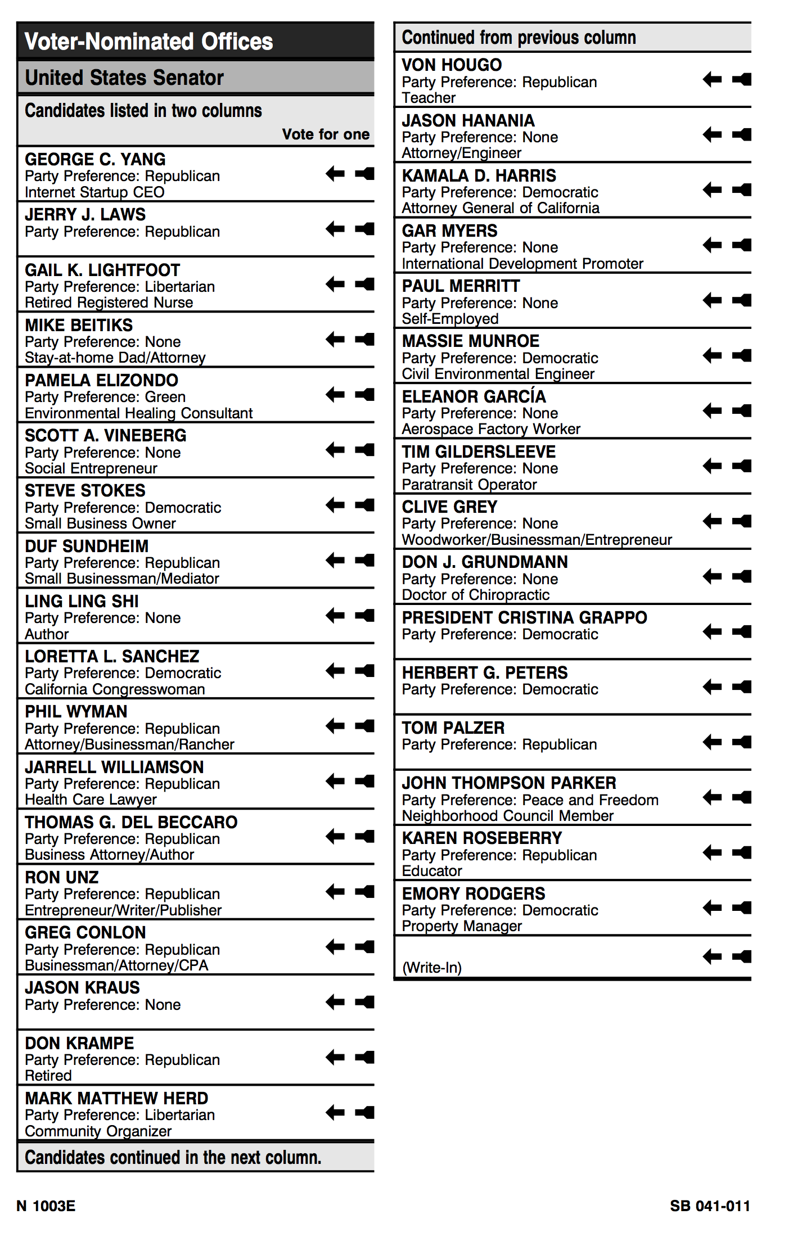
③
①
Column-level headings & footers
Two column Senate layout
1. Title of race indicated by 3 levels of shading
2. Column 1 additional footer
…“Continued in the next column”
3. Column 2 additional heading
…“Continued from previous column”
Shown: San Bernardino
②

Slide 33
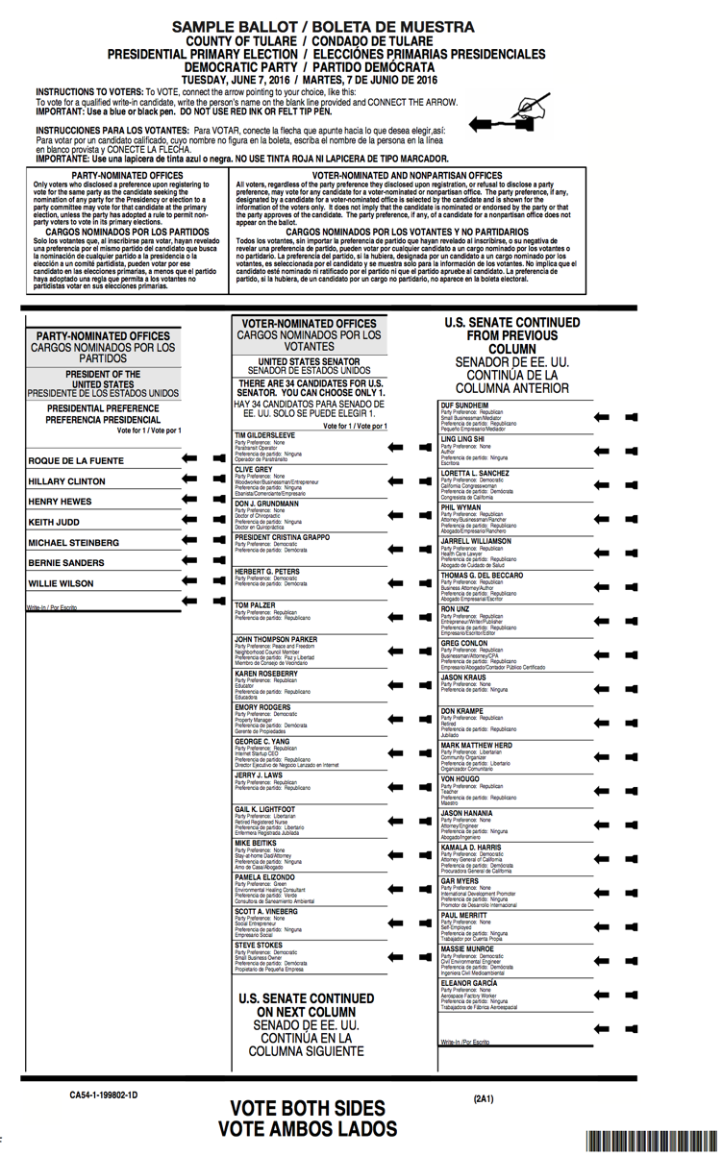
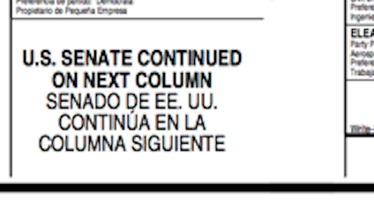
①
③
②
Column-level headings & footers
Instructions span two columns
Contest top has labels but no shading
Reminders at end of column 1 and top of column 2
Shown: Tulare
③
Column-level labels for 2 column layout Callouts show footer and heading for columns

Slide 34
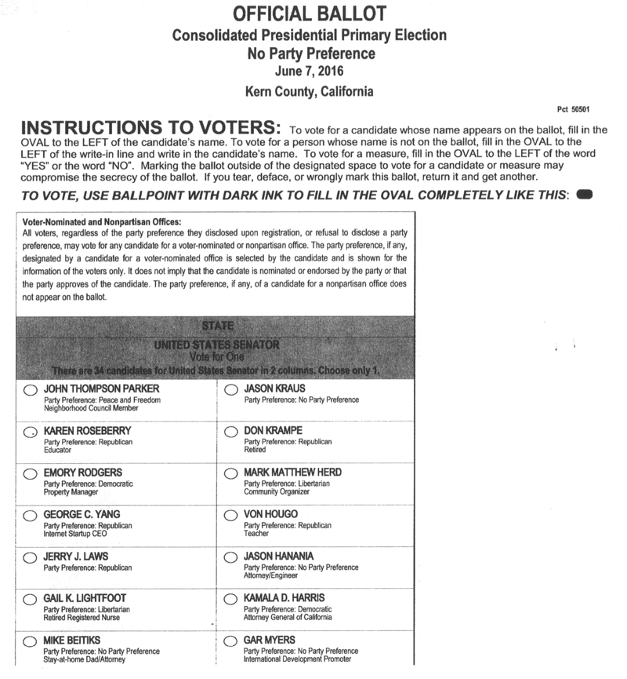
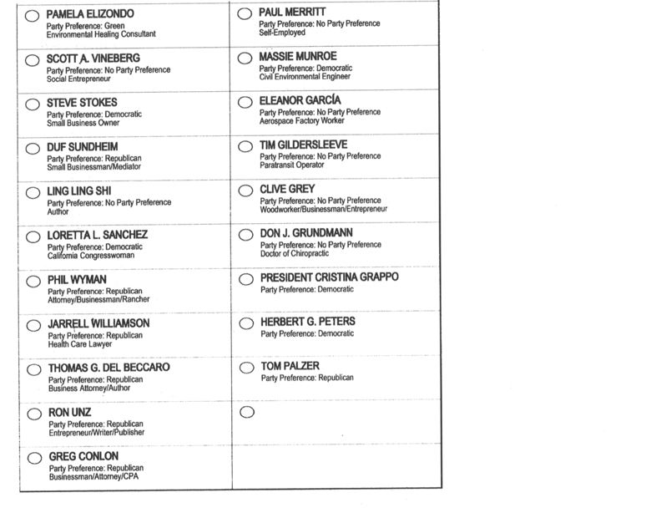
Instructions & contest title span all columns
NPP contest with 2 columns (or 3 columns)
Contest title with shading
Instructions paragraph, no shading
Used by: 16 counties
Shown: Kern

Slide 35
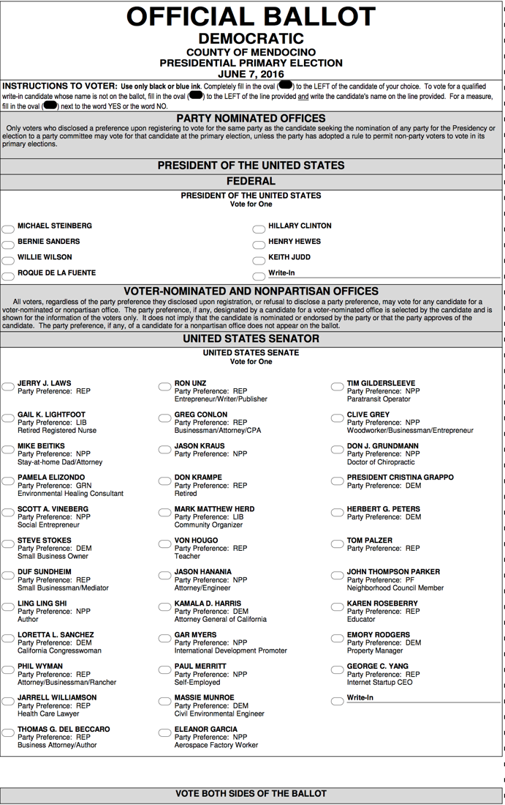
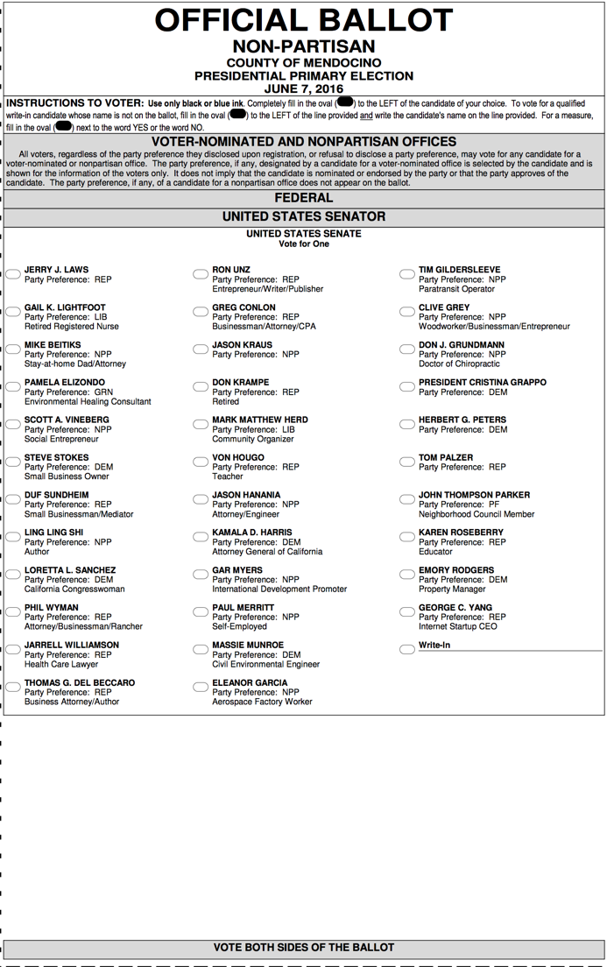
Unifying 3 columns
Instructions span all 3 columns
Contest title and Vote for One center-aligned
No columnar lines
Shown: Mendocino
Party ballot
No Party Preference ballot

Slide 36
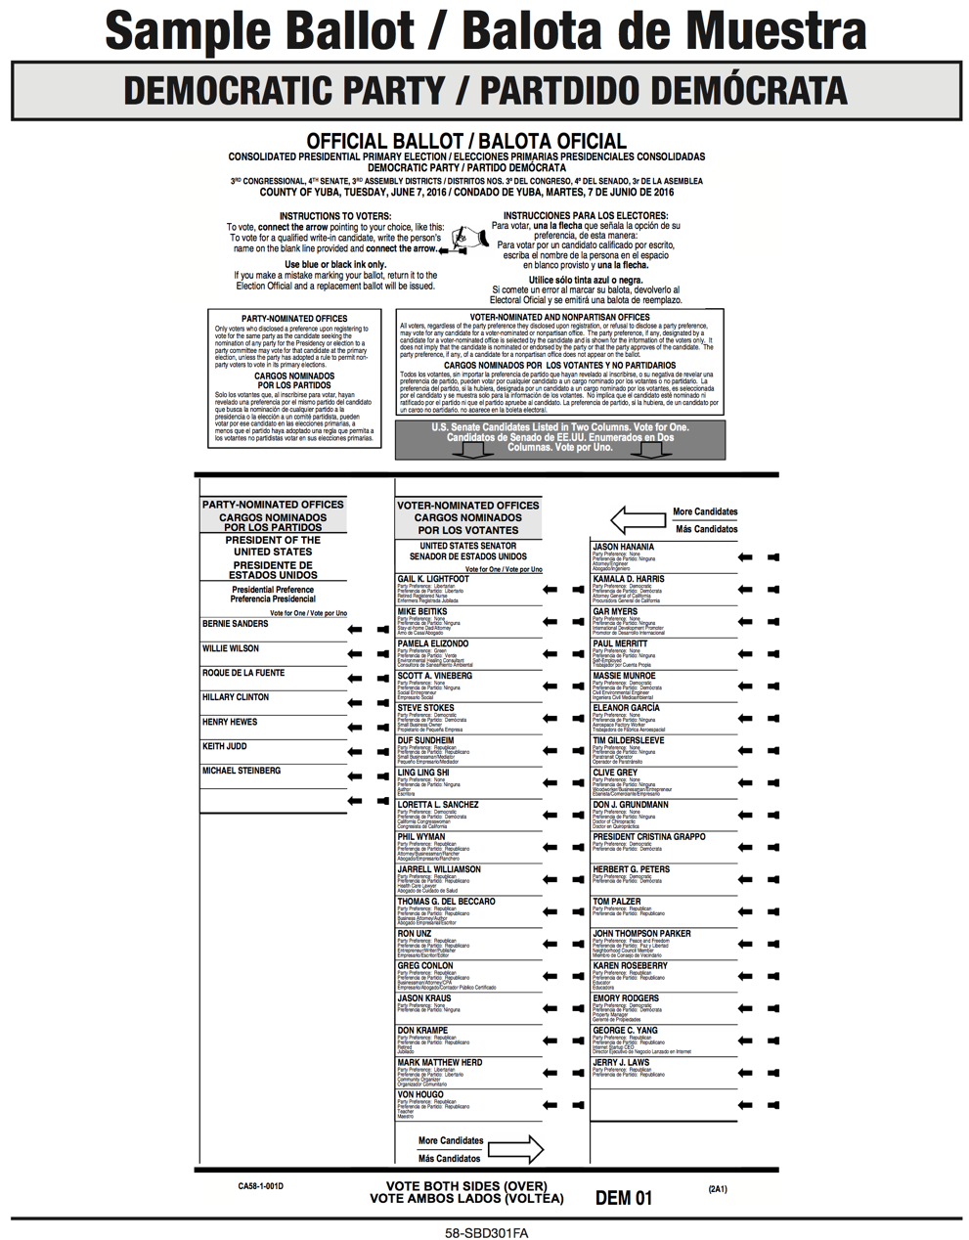
Column headings and footers with arrows
Instructions span columns
Bottom of center column “More candidates” with
Top of righthand column “More candidates” with
Used by: 2 counties
Shown: Yuba
Arrows along with column heading / footer

Slide 37
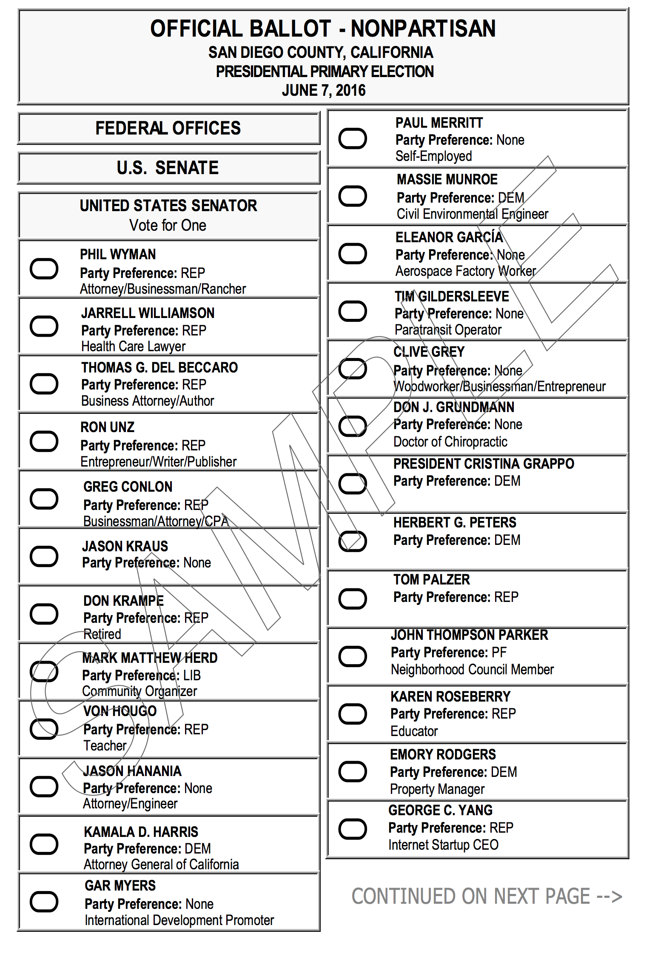
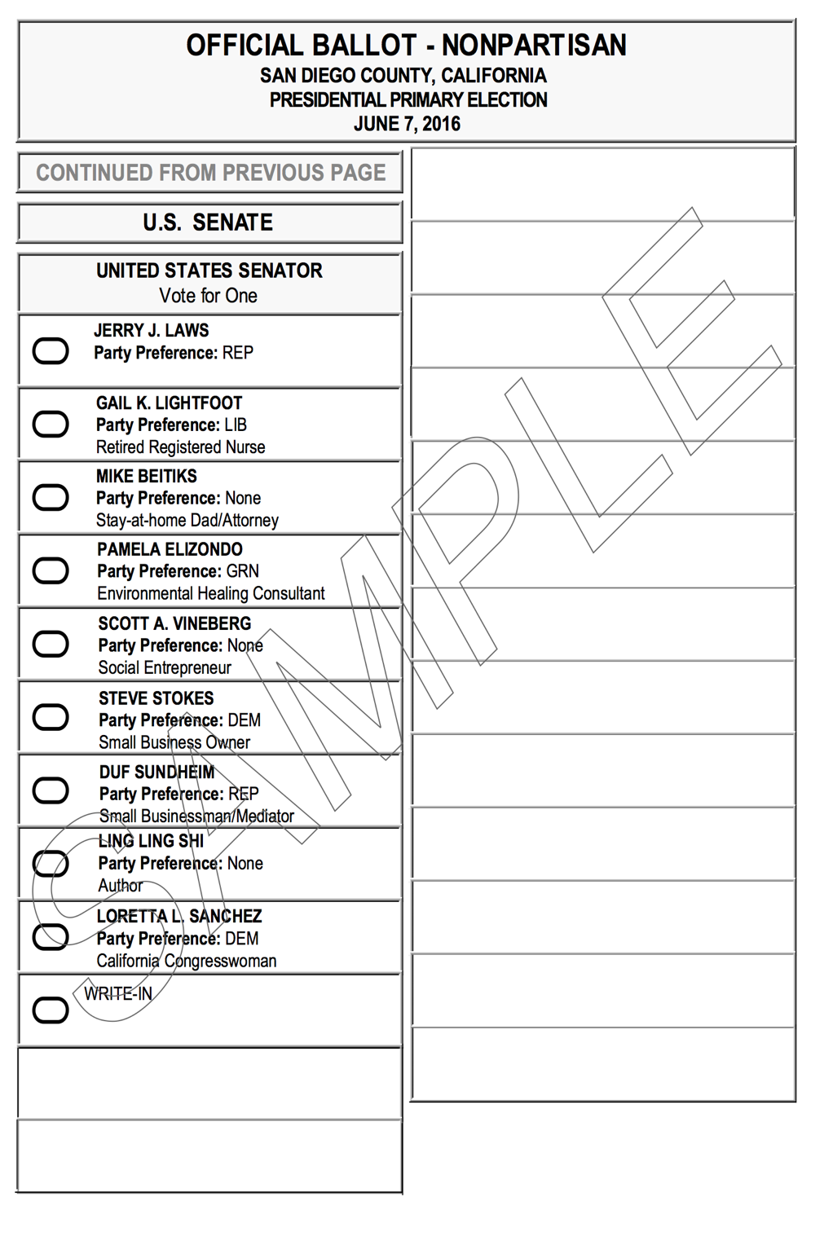
Column headings and footers
Instructions on preceding page (not shown)
Contest title on Column 1
No message at top of Column 2
Columns 1 & 2 staggered
Message at bottom of Column 2: “Continued on next page” with arrow
Third column on new page repeats Contest title Shown: San Diego
2 column layout across 2 pages

Slide 38
Special instructions in the Voter Guide
3 counties devoted space to voter education about this contest

Slide 39
Voter guide and deadlines
Counties found many ways to alert voters about selecting one of 34 candidates.
Some counties had printed their guides by the time the ballots were being laid out.
Postcards, web, social media all were harnessed.
Three counties managed to fit a custom message about only 1 vote for this contest into the guide.

Slide 40
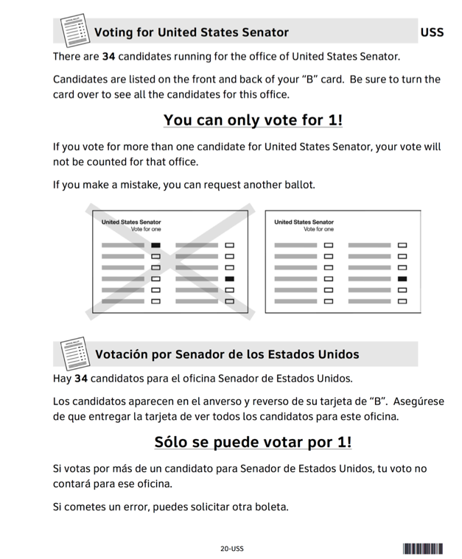
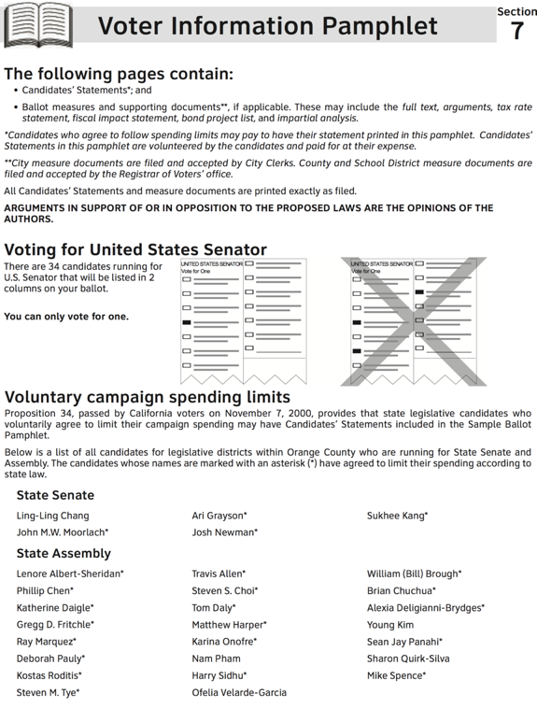
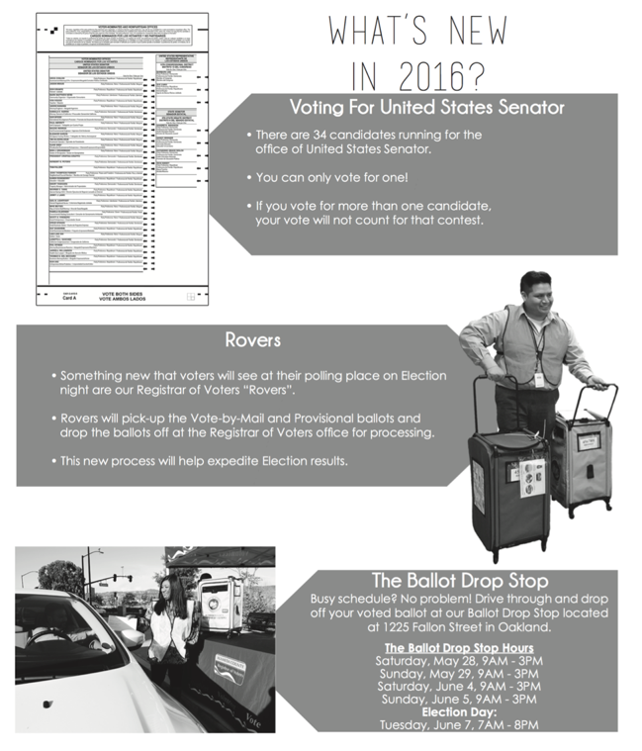
Provide voter ed in Voter Guide “You can only vote for 1”
Madera County dedicated a whole page, including a reminder: Candidates appear on front & back
Orange County fit a paragraph and 2 illustrations between mandated language
Alameda County put Voting for US Senator first on its page
What’s New in 2016?

Slide 41
Instructions in the ballot
All 58 counties included mandated language on the ballot

Slide 42
Mandated instructions
Mandated instructions often appear above relevant column or columns
Sometimes these instructions appear in the column to the left, which can also mean on previous page.

Slide 43
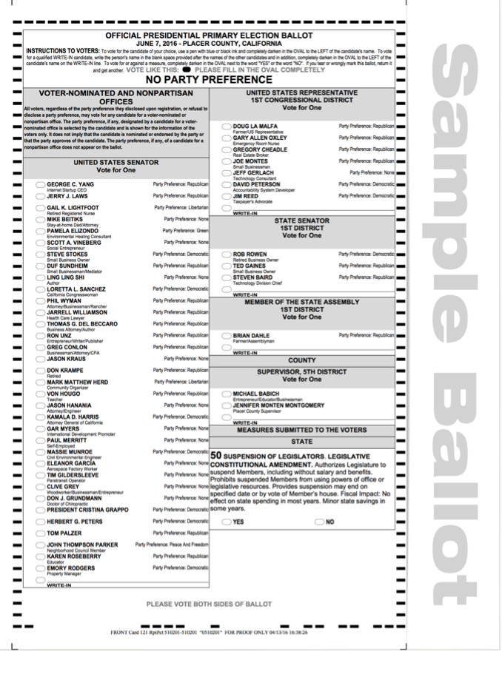
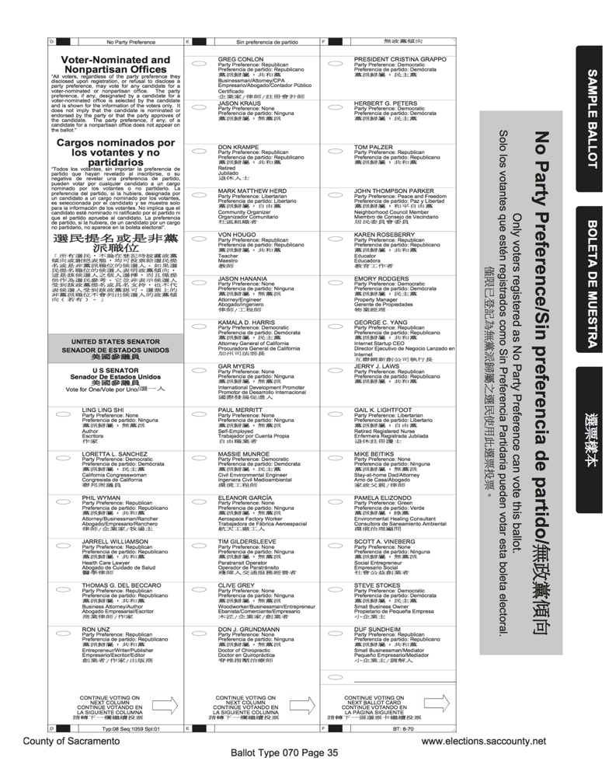
Placement of Instructions
Above the contest, usually
Spans columns, or
In only 1 column
Shown: Placer (left)
Sacramento (right)
Voter-nominated offices Instructions above contest
Voter-nominated offices Instructions above contest

Slide 44
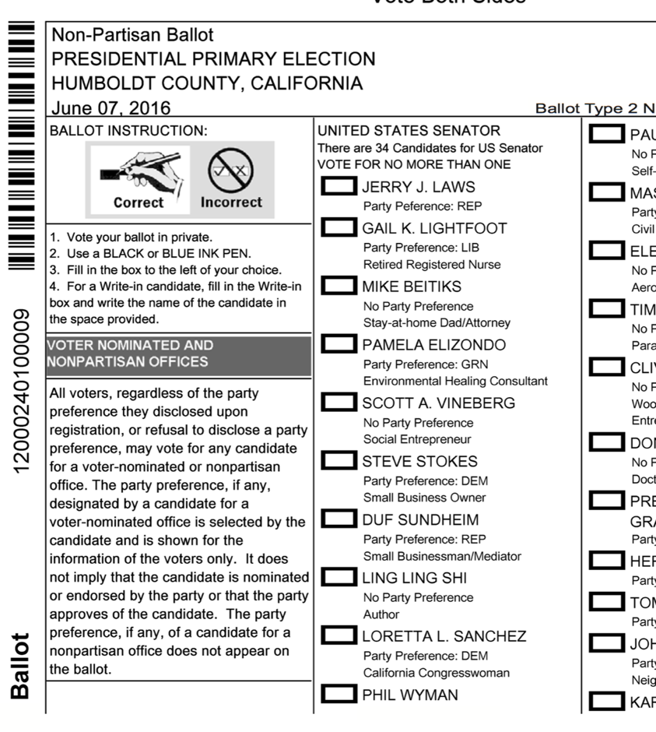
Placement of Instructions
May appear in column to left of contest
May appear on preceding page, to allow space for 34 candidate names
Shown: Humboldt (left)
Shasta (right)
Voter-nominated offices Instructions in previous column
Front of ballot

Slide 45
Vote for One
Each contest makes number of possible votes explicit.

Slide 46
“Vote for One” reminder
Each contest mentions how many votes can be cast.
How is the message displayed?
Left-aligned
Centered
Right-aligned
Mixed
Does one pattern work better than another?
It’s worth looking at the alignment of message to location where voter makes marks (oval to left of name, arrow on right of name …)

Slide 47
Vote for One (Left-aligned)
Contest Titles appear above
Many counties included message about “34 candidates for US Senate”
Vote for One appears left aligned in one column layout (above) and in two column layout (below)
Voter marks on left of name
Used by: 11 counties
Shown: Butte (above)
San Mateo (below)
Left aligned (one wide column)
Left aligned (two columns)

Slide 48
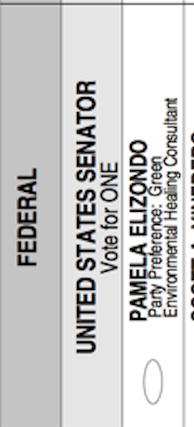
Center aligned (three columns)
Vote for One (Centered)
Contest Titles appear above candidate names
Many counties included message about “34 candidates for US Senate”
Vote for One appears center aligned in the wide one-column layout (bottom) and in three-column layout (top)
Used by: 22 counties
Shown: Mendocino (top)
Calaveras (middle)
Tuolumne (bottom)
Center aligned (one column)
Center aligned (one wide column)

Slide 49
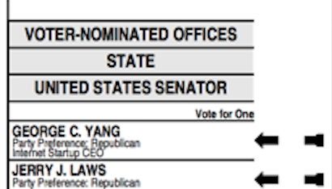
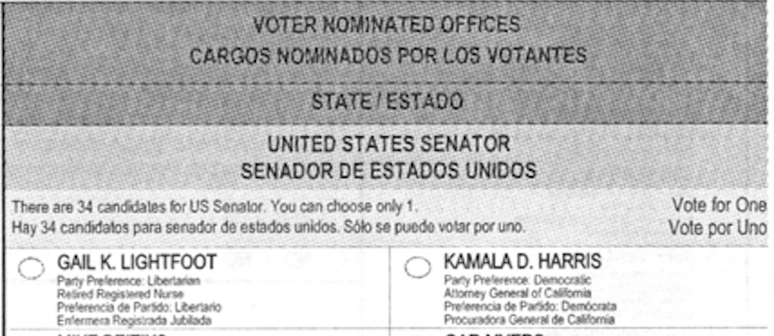
Vote for One (Right-Aligned)
Contest Titles appear above
Many counties included message about “34 candidates for US Senate”
Vote for One appears right aligned in one column layout (above) and in two column layout (below)
Voter marks ballot on right of name (above) or on left of name (below)
Used by: 22 counties
Shown: Shasta (above)
Glenn (below)
Right-aligned (one column)
Right-aligned (two columns)

Slide 50
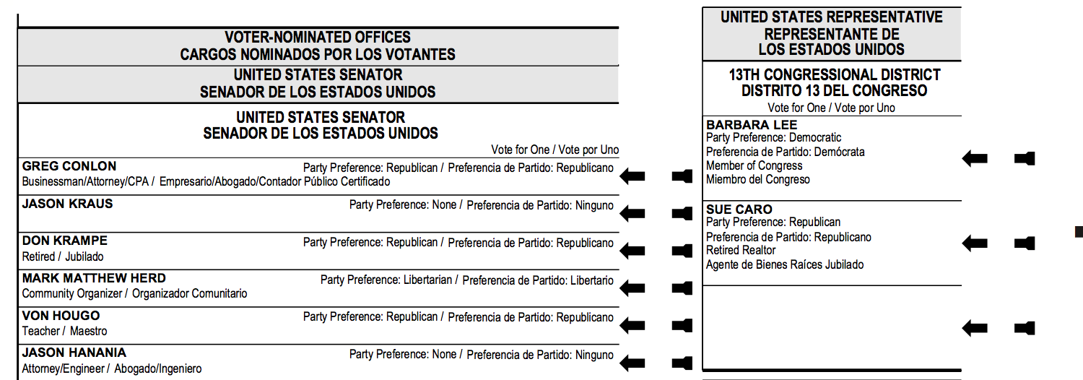
Vote for One (mixed alignment)
1 double width column for Senate
1 regular width column for other offices
Heading spans width
Vote for one
Right aligned for Senate
Center aligned for other offices
Used by: 3 counties
Shown: Alameda

