Slide 1
Best practices for official voter guides Layout and organization of voter guide content
Center for Civic Design
Project page and links to resources:
http://civicdesign.org/projects/how-voters-get-information/
This work is funded by the Irvine Foundation and the Future of California Election, and created in cooperation with the League of Women Voters of California Education Fund and Shasta, Santa Cruz and Orange Counties.

Slide 2
Contents
Creating page types
Front cover | 1
Table of contents | 2
First page in a section | 3
Ways to vote first page | 4
Ways to vote pages | 5
On this ballot first page | 6
Measure overview | 7
Measures pages | 8
Practice ballots | 9
Resources
Templates in Word | R1
Page headers | R2
Ilustrations and ions | R3
Choosing fonts | R4
Colors | R5
Best practice manual & Field Guides | R6
Examples are from the prototype Santa Cruz November 2014 guide created for testing, available on the project resources page.

Slide 3
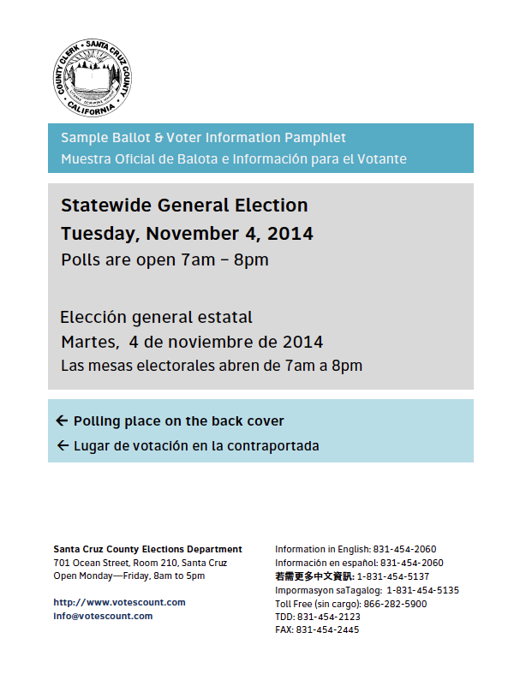
Front cover
1
Show what the document is and what it covers
The cover is the information "bite" – a minimal summary of what the booklet is about. Include:
The name of the county / county seal
The title of the book
The type and date of the election
Election Day hours (or that it is an all-mail election)
How to find the polling place
Contact information
An indication of all languages available
Keep the cover clean and simple. Don't include messages, news, or warnings.
Keep the county seal at the top-left of the page, for consistency across counties.
Experienced voters said that the information on the cover was often all they needed to know.

Slide 4
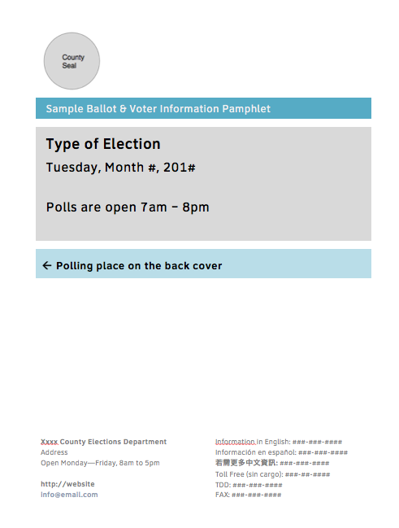
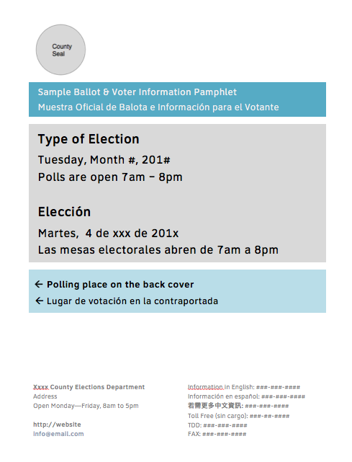
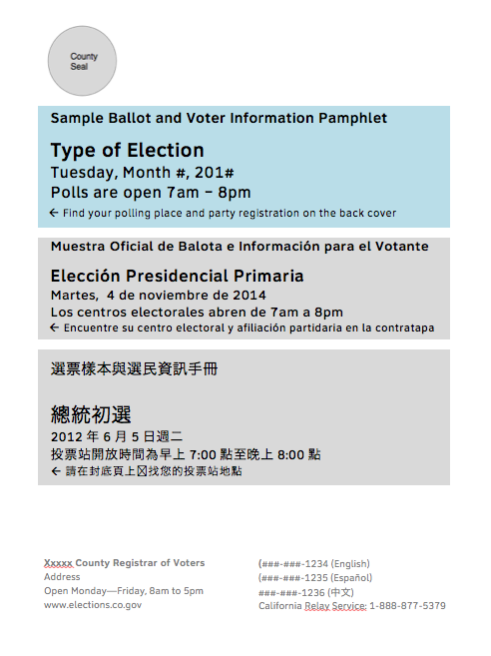
Layout notes for multiple languages on the cover
1a
How to adjust the layout for one, two, or three languages.
Word Tip
The front cover uses a table to manage the spacing and set background colors.
The contact information is in the footer, so that it is always at the bottom of the page.

Slide 5
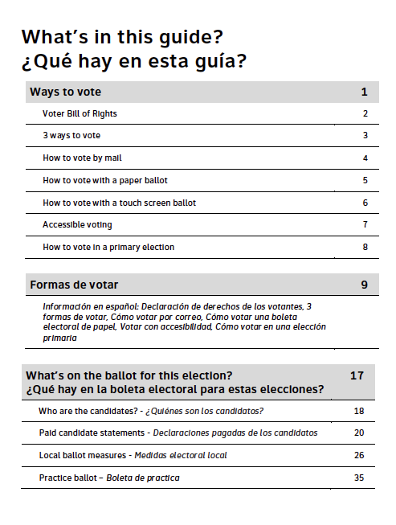
Table of contents
2
Help voters see at a glance what is in the guide
The voter sees the table of contents immediately after opening the cover.
Break the table of contents into the main sections of the guide.
Use large text and white space to make the text easy to read.
Include page numbers to help voters find the specific information they are looking for.
Show the starting page for information in other languages. Use that section opening page to show the contents of that section.
Voters used the table of contents as their "home page" as they read a voter guide. Even in small books, they often kept their finger at the contents to come back to and find the next page they wanted to read.

Slide 6
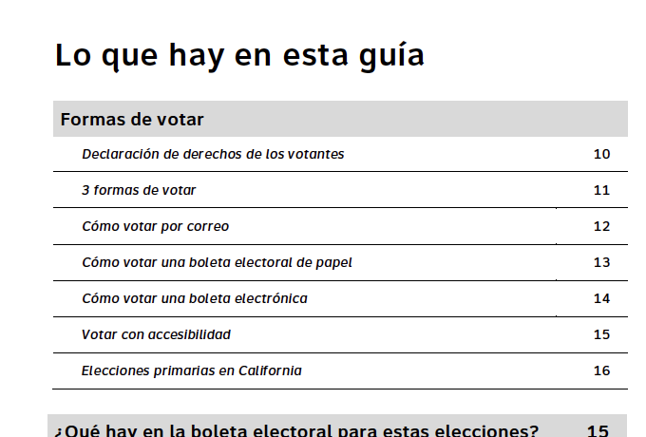
Notes for the Table of Contents
2a
Page numbers and ballot styles
If your content management system supports creating sequential page numbers for the entire book, this is ideal.
If not:
Include at least the opening page number for each section in the table of contents
Use "chapter numbering" for the measure pages, using the measure letter and a number (K1, K2, K3...)
See notes on layout for the first pages in each chapter for more on page numbers (starting on the next page).
Bilingual table of contents
Be sure both languages are visible in the table of contents, showing whether the content is shown in both languages within a section, or if there are separate sections for each language.
If there are separate sections, the second language should have it's own table of contents at the start of the section.

Slide 7
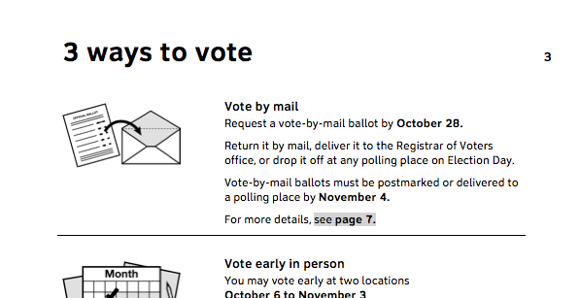
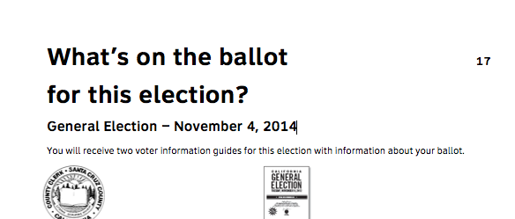
First page in a "chapter"
3
Help voters identify the start of a new section
The first page of a "chapter" is a summary of the contents of the pages that follow.
A different look to the page layout signals a new section of the site.
The top of the page has no banner.
The page layout is unique.
The chapter title is in large text.
The body text is larger than the detail pages.
Even a small change in the look of the top of the page helped voters find the beginning of a section as they flipped through the book.

Slide 8
Notes for the layout of the first page in a chapter
3a
The text on these pages should be larger than the normal body text to make these pages stand out.
Don't clutter these pages. The first page of a chapter acts as a summary, pointing to further detail.
Try to start each section or measure on an odd-numbered (right side) page, using filler pages as needed.
The table of contents should be page 1 of the interior pages
"Ways to vote" goes on 3 of the interior pages (following the Voter Bill of Rights)
"What's on the ballot" may need a filler page before it.
Word Tips
Use the style "Chapter Title" to keep the text size consistent.
Use styles
Cover-body is a larger type (12pts vs. 11pts)
TOC-heading is for the sections of the contents
TOC-page is for the individual entries

Slide 9
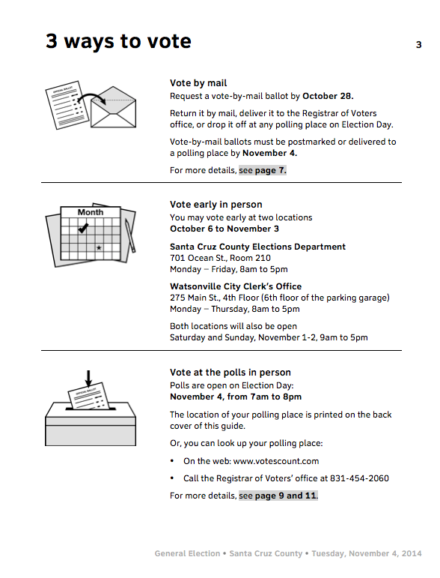
Ways to Vote opening page
4
Summarize the options to vote to help voters choose
If the cover is the "bite," this page is the "snack" with the details of when and where to vote, but not all of the detail of the pages that follow. Show
Dates
Addresses
Hours
Where to find more information in the guide
Use the images on this page in the banners for the details pages in this section.
Some voters thought that they were vote-by-mail voters because they got their guide in the mail.
Experienced voters appreciated seeing all the information about places, dates, and times on one page.

Slide 10
Notes for the Ways to Vote overview
4a
New voters don't know that there is more than one way to vote. Showing the options on one page, with clear wording, helped them see that they have choices.
Vote by mail
Vote early in person
Vote in person at the polls
Adjust this page to reflect the number of ways to vote in your county.
Don't treat "Saturday voting" as a different way to vote – it's another form of voting early in person.
Include a reference to the detail pages so voters who need more information can find it easily.
Word Tips
Use bold text to highlight dates and location names. It makes the information stand out on the page.

Slide 11
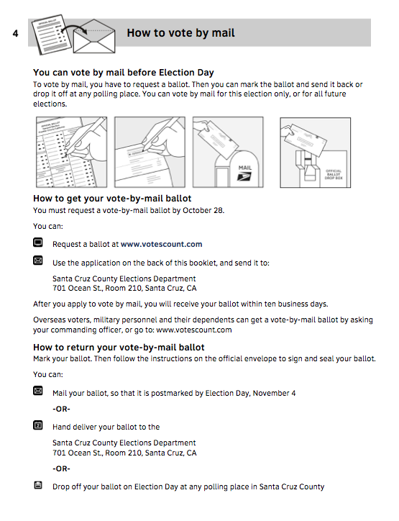
Ways to vote detail pages
5
Tell voters what they need to know about how to vote
In the Ways to Vote detail pages:
Cover one topic per page. Don't hide extra information at the bottom of the page.
Help voters get an overview of each topic both visually and with text.
You don't have to repeat information from the opening page.
Voters liked the visual explanations with minimal text. It made them feel that it would not be too difficult to vote.

Slide 12
Notes for the pages in the Ways to Vote section
5
Pages in this section include, as needed, any instruction for How to Vote:
How to vote by mail
How to vote at the polls
How to vote early in person
How to vote with a paper ballot
How to vote with the voting system
How to vote in a primary
Accessible voting
Language assistance
These pages are included in all ballot styles, so the page numbers from the Table of Contents through the last page in this section can be consistent.
Word Tips
The basic text styles are:
Body (11pts)
Body-Bullets (sets bullets to the left margin, and doesn't add space between bullets)
Body-ListIntro (less space after the paragraph, so it closes the gap to the list that follows)
Use the heading styles
Heading 2 – for sections on the page
Heading 3 – if needed for a second level

Slide 13
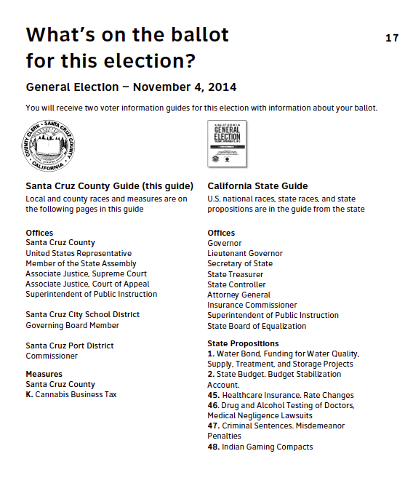
On this ballot page
6
Help voters see at a glance what they are voting for
This page introduces the section of candidate and measure information, and the practice ballot. It lists the contents of the ballot, by ballot type.
List the election type and date on the page.
The two columns show what is in the county and state guides.
Use your county seal or a thumbnail of the county guide cover.
List contests in the order they appear on the ballot.
Voters insisted they had seen this page before, even though it was new. They liked seeing a simple list of the contests.
Having the two lists helped people see that they might get multiple guides – in this case, one from the county and one from the state.

Slide 14
Notes for the What's on the ballot page
6a
This page can be created for each ballot style or can be generic covering all ballot styles.
Use the short title of measures and propositions. You can truncate them if necessary.
Word tips
If you have a very long ballot, adjust the line spacing as needed to make it all fit.
If possible, make this an odd-numbered (right side) page. Use a filler page before it if necessary.

Slide 15
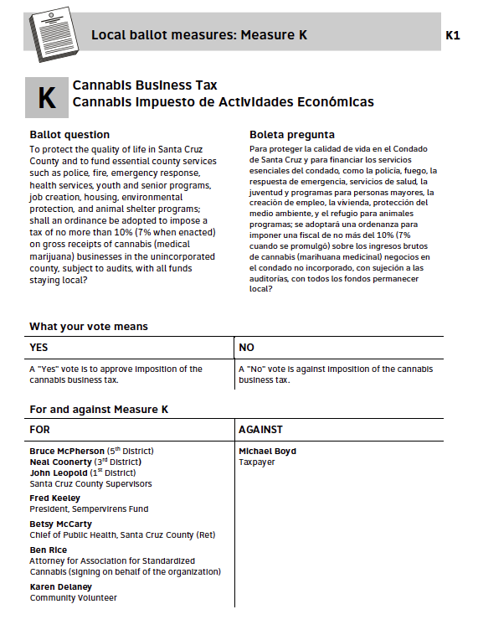
Measure overview page
7
Help voters learn about a ballot question
The measure overview page provides a brief view of the measure before pages related to that measure. It includes:
The ballot question text
What your vote means (from the impartial analysis)
Who is for and against the measure (from first argument)
Terminology
"What your vote means" The column headings (Yes/No) should match the ballot language
"For and against Measure X" (not pro and con)
Voters said that this page was one they "always read" even though it's a newly designed page. It's just enough information for them to get started, and have some context for the pages that follow.

Slide 16
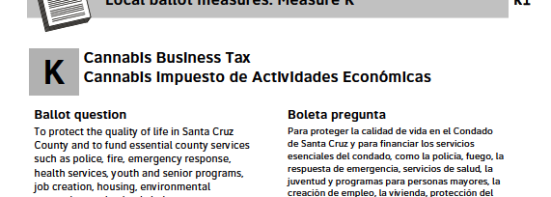
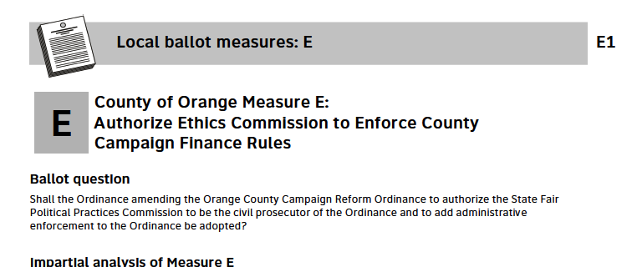
Notes for the Measure Overview page
7a
If you translate the ballot question, but do not fully translate the rest of the information, include the translated question on this page.
If you do not want to add a whole page for the measure overview, start with the ballot question, so voters know what they will be asked on the ballot, then continue with the other sections.
Word Tips
The measure pages have their own styles so you can adjust them separately from other pages.
Measure-first-page –11pts (same as body), Measure-detail and Measure-detail-bullets - 9pts.
Section headings use H2.
Use the Word header feature in measures pages, so text can flow from page to page as needed.
Number the pages in each measure with the measure letter or number (K1, K2...) so it's easy to put them together into different ballot styles.

Slide 17
Measures – Arguments, Analysis, Full Text
8
Information about the measures, to help voters decide how to vote
1. Arguments and replies
(on two pages)
Organize the measures information in this order:
Measure overview (with ballot language)
Arguments for and against
Replies to arguments against and for
Impartial analysis and fiscal impact (if included)
Full text
Put the names of authors
At the bottom of the arguments
At the top of the official analyses
2. Official analysis
(flow on pages as needed)
3. Full text
(flow on pages as needed)
Voters said they often started with the arguments, using them as a way to get a sense of the issue.
When the analysis is written well, voters find it useful.
They rarely read the full text, but want it available.

Slide 18
Implementation notes for the Measures Information
8a
Order of the arguments
Set up the pages so the "sides" of the argument stay on the same side of the page
First page
(L) Argument for (R) Argument against
Second page
(L) Reply to against (R) Reply to for
Page order
If you do not include the measure overview page, we suggest:
Ballot language
Official analyses
Arguments and replies
Full text
Word Tips
The templates use tables to manage the layout of the arguments. Use "Distribute Columns Evenly" to be sure space is equal.
Use the Measure-detail-bullets style to keep the layout of bullets consistent.
If you have to squeeze the text to stay on a page, adjust in this order:
Reduce space before headings
Reduce space between bullets
Reduce space after paragraphs
Reduce font by half a point

Slide 19
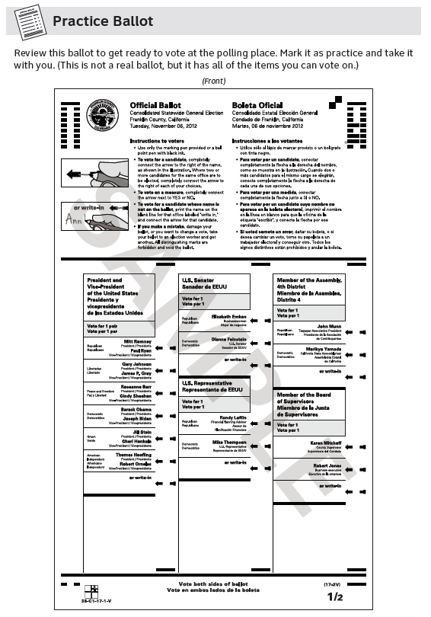
Practice Ballot
9
A copy of the ballot the voter will use
We suggest using the title "Practice Ballot."
If you have room at the top or side of the page, add instructions:
Review this ballot to get ready to vote at the polling place. Mark it as practice and take it with you. (This is not a real ballot, but it has all of the items you can vote on.)
New voters, voters who don't read well, and voters who don't read English well all worried about making mistakes, but did not understand that they could use the "sample ballot" to prepare and practice.

Slide 20
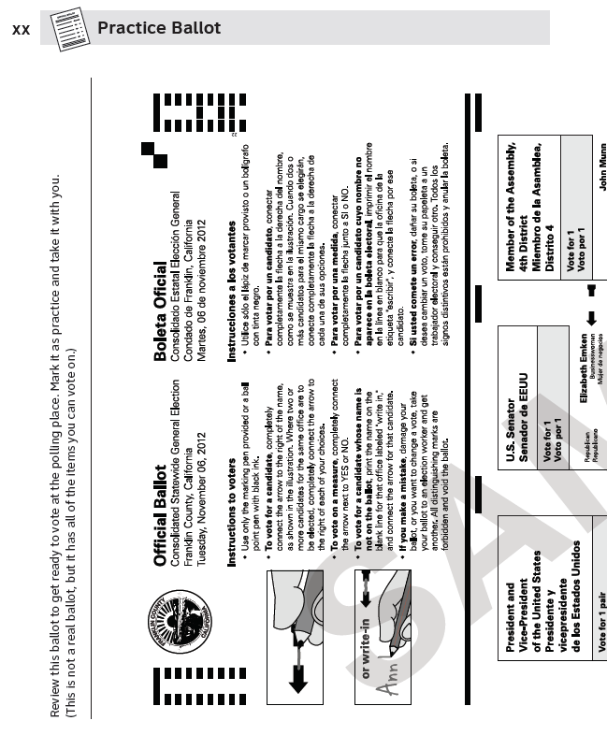
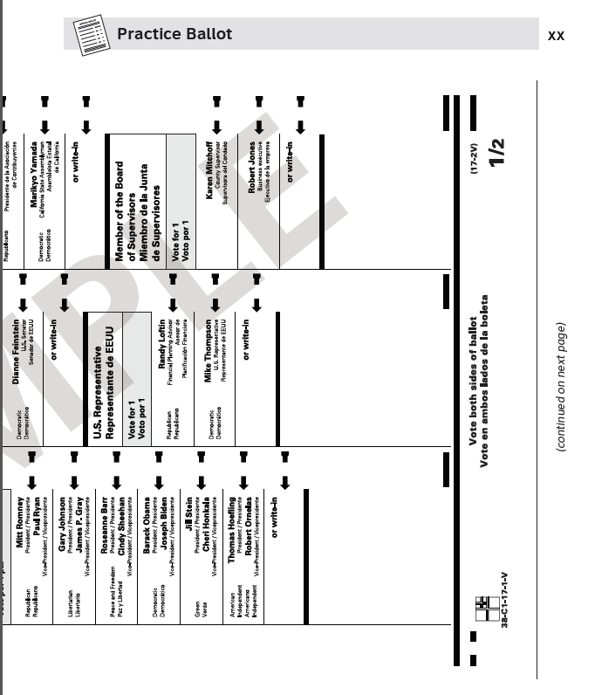
Notes for how to include the practice ballots in the guide
9a
Vertical or horizontal?
Both options have advantages and disadvantages of how easy it is to read vs. how easy it is to see the whole ballot page.
Horizontal ballot layouts must start on an even-numbered page, so the ballot fills a two- page spread.
Where to put the practice ballots?
We suggest putting the sample ballots at the back of the voter guide, so they are easy to find and don't interrupt the other informational pages.
If you have a bilingual guide, with two sets of pages, you can also put the ballots in between the sections.
Some counties use a full-sized ballot with no page numbers or page headers, "blowing in" the correct ballot style in the center of the booklet.

Slide 21
Templates
R1
Starter files with formatting and sample text
Templates Starter files for all the different types of content
All files are in Microsoft Word .DOCX format
Cover Front cover, ROV letter, back cover with postcard, English and bilingual, and a tri-lingual cover
Ways to Vote Table of Contents, Ways to Vote, and sample pages to edit
Ballot-Candidates (and bilingual) On the ballot page, candidate endorsements and mandatory text, and candidate statements
Measures All pages for a measure, ready to add content
Practice Ballot Pages set up with headers for the practice ballot

Slide 22
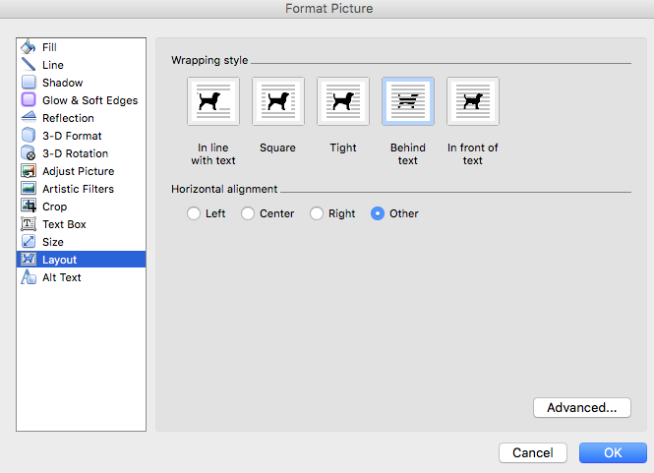
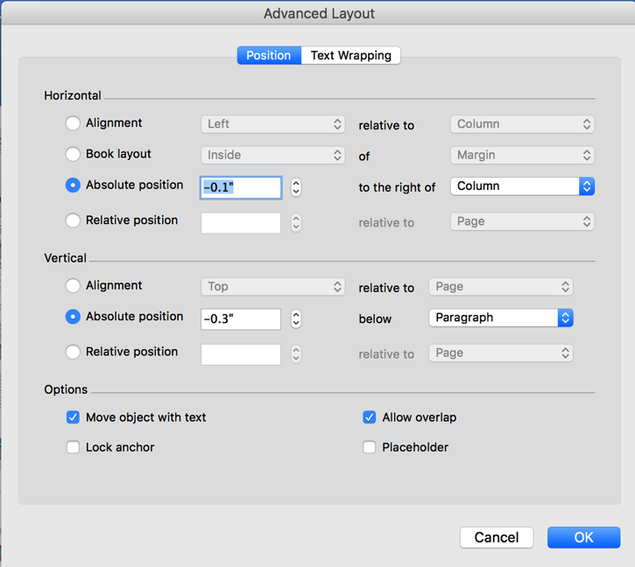
Page headers
R2
Tips for placing them on the page consistently
Word Tips
The page headers are set up with different odd and even pages.
Page numbers are inserted as a field in Word.
Don't use the basic page number function as it doesn't allow you to set the position.
Headers can be tricky in Word.
To make it easier to manage, lay out all of your pages first, then put in the headers, so you know which ones are on the left and which are on the right.
In the On the Ballot section, where content takes up more than one page, the banners are in the Word header. To change the page header, you have to make a new "section"
In the Ways to Vote section, where each page is a new topic, we've put the banners at the top of the page content (but not in the Word header) so it's easier to manage.
To make sure the page banners are always in the same place:
set the image wraping to "behind text"
set the position to the same absolute settings on each page
use tabs to set the position of the page number and the page title (You will have to adjust the tab for the title around the icon.)

Slide 23
Images for page headers
R2a
Help voters identify the kind of information on the page
Vote by mail
Vote early in person
Vote in person at the polls
Candidates
(Who is running)
Measures
Language
Disability
Bill of Rights
Practice Ballot
Questions/FAQ
Generic
Sample page banner with embedded icon

Slide 24
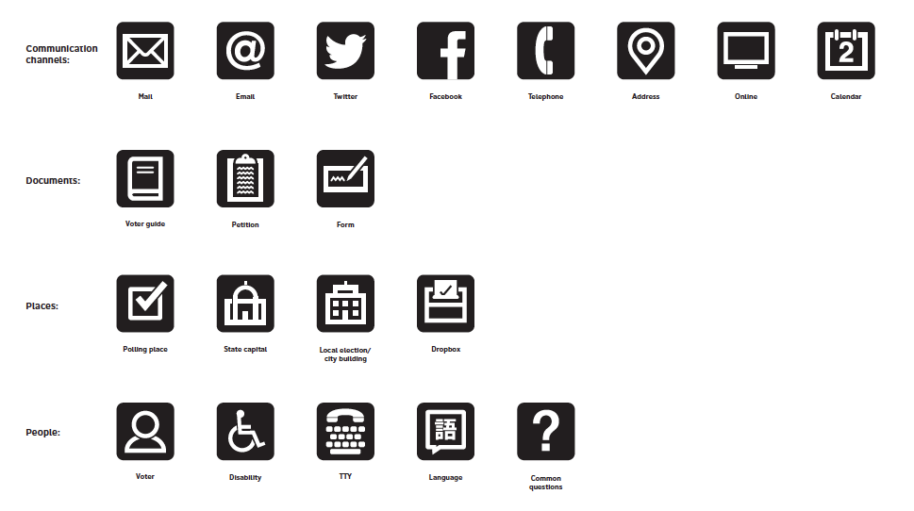
Icons to identify types of information
R3a
Help voters see different types of contacts or places
Word Tip
Scale the icon to .19 x .19 in Word and it will fit next to text in the Body style.

Slide 25
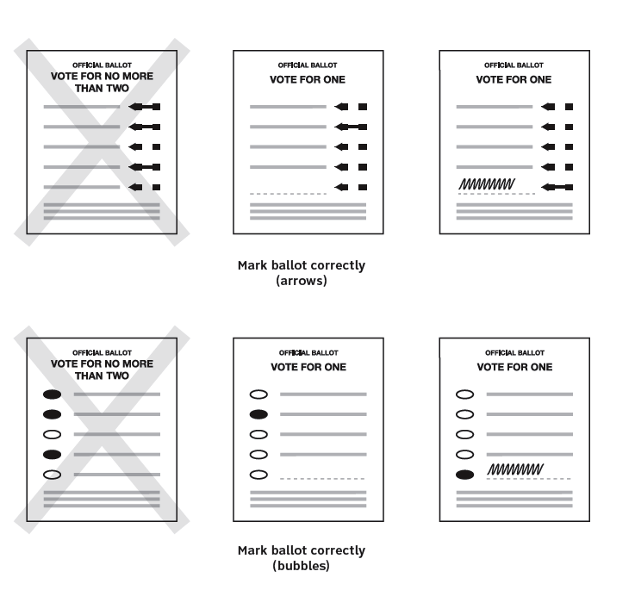
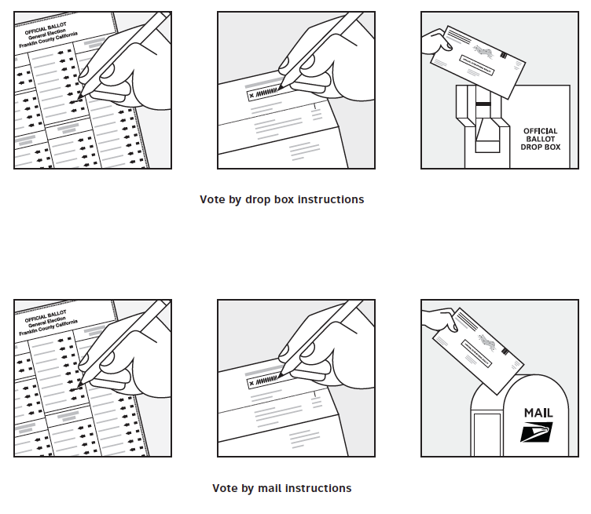
Illustrations for visual explanations
R3b
Help voters see the steps in a process, visually
Samples of the illustrations

Slide 26
Choosing a font
R4
The typeface matters in ease-of-reading
The templates use the Clearview ADA font, because we think it's a nice, clear, easy-to-read font that helps people with reading disabilities such as dyslexia.
Terminal Design, which created and sells Clearview ADA offers a 20% discount to election departments. Use discount code clvadaelec
http://www.terminaldesign.com/fonts/clearviewada-complete-family/
The Clearview font family includes:
Light
Regular
Medium
Demi-Bold
Bold
and italics of all styles
However, any clean sans-serif font – like Arial, Calibri, Helvetica, or Univers – will also work.
If you do not want to use Clearview, Calibri will give you similar spacing and layout in the templates.

Slide 27
Using color
R5
On the cover, inside, or to coordinate all of your materials
Election materials color palette (for use consistently in all print and digital applications)
These contrast ratios meet or exceed WCAG 2.0 accessibility requirements.
PDF file: VoterGuide-Color-Palette

Slide 28
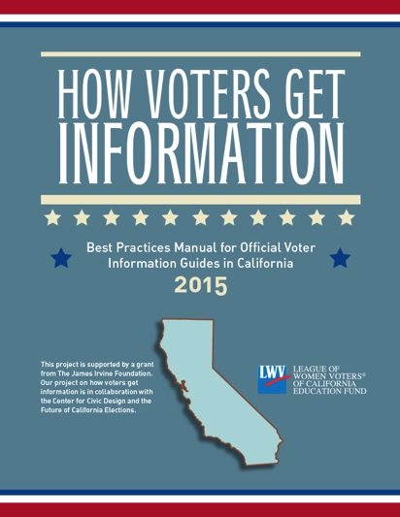
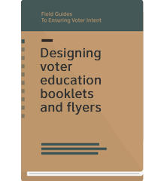
Best practices manual and the Field Guides
R7
How voters get information:
Best practices manual for official voter information guides in California
Available from https://cavotes.org/download-best-practices-manual
Field Guides to Ensuring Voter Intent
Design guidelines for election officials, based on solid research and best practices
Available from http://civicdesign.org/fieldguides/

