Slide 1
Implementing the Best Practices for California Voter Guides Updating your Voter Information Packet for 2016
Nancy Frishberg
Whitney Quesenbery
Center for Civic Design
Allison Denofrio
Assistant County Clerk/ Registrar of Voters
Shasta County
February 3, 2016

Slide 2
About this project
Developed materials based on the recommendations from our 2014 Best Practices Manual
Collaborated with 3 California counties to review and revise their voter information pamphlets and other voter information
Got feedback from voters directly
Sharing with all California election offices to promote best practices in the 2016 election and beyond
http://civicdesign.org/projects/how-voters-get-information/
Notes:
http://civicdesign.org/projects/how-voters-get-information/

Slide 3
Reviewing the Best Practices Webinars
https://cavotes.org/announcement/2015/apr/sign-our-voter-guide-best-practices-webinars

Slide 4
Research-based recommendations
Civic literacy is a huge challenge
Layout and visual presentation are important for comprehension
Plain language can’t be overemphasized
People didn’t know common election words
Voter Bill of Rights is valuable, but hard to read
Use the checklist
Notes:
https://cavotes.org/announcement/2015/apr/sign-our-voter-guide-best-practices-webinars
Slides: https://cavotes.org/sites/default/files/jobs/Webinar1-Overview-2015-0427.pdf

Slide 5
Layout and navigation give readers a roadmap and guidance on the way
Use layout to convey content
Help readers find their way
Show readers where they are
Use design to guide the voter
Include a practice ballot
Make information visual
Use accurate instructional illustrations
Make text big enough
Use upper- and lowercase (not all caps)
Avoid centered type
Use one sans-serif font
Notes:
https://cavotes.org/announcement/2015/apr/sign-our-voter-guide-best-practices-webinars
Slides: https://cavotes.org/sites/default/files/jobs/Webinar2-Visual-Presentation-2015-0427.pdf

Slide 6
Organizing information helps all
Provide a table of contents with page numbers
Give information about the logistics of voting
Connect the County guide and State guide
Organize information by task, one topic per page
Use page layout to make differences stand out
Help voters find their way, with headings and illustrations
Maximize the value of the front cover (10 sec glance)
Organize information into bite-snack-meal chunks
Include overview and details
Make it easy to compare candidates
Voters prefer structured information
….and some wanted as much information as possible
Notes:
https://cavotes.org/announcement/2015/apr/sign-our-voter-guide-best-practices-webinars
Slides: https://cavotes.org/sites/default/files/jobs/Webinar3-Civic%20Literacy-2015-0423.pdf

Slide 7
Plain language improves understanding for all
Write in short sentences, short paragraphs
Use everyday words, not election terminology
Write in active voice, directly to readers
Keep message positive
Separate paragraphs with space
Use large enough type (12 pt or above)
Use a recommended san-serif font
Write headings as questions or active instructions
Notes:
https://cavotes.org/announcement/2015/apr/sign-our-voter-guide-best-practices-webinars
Slides:
https://cavotes.org/sites/default/files/jobs/Webinar4-Plain%20Language-2015-0423.pdf

Slide 8
Best practices manual for official voter guides in California
https://cavotes.org/announcement/2015/feb/best-practices-manual-official-voter-information-guides-released
Notes:
Download manual at https://cavotes.org/announcement/2015/feb/best-practices-manual-official-voter-information-guides-released

Slide 9
Materials & metaphors

Slide 10
What materials are we discussing today?
Key resources for this training
Layout and organization of voter guide content (PDF and PPTX)
Templates for voter guide pages (zipped files)
Cover
Ways to vote
Ballot-Candidates
Measures
Practice Ballot
Illustrations and icons
Clearview ADA font
Additional resources
Sample voter guides
Prototype voter guide for “Franklin County”
Santa Cruz County 2014 packet reworked with the new format
Voter Information Packet, Santa Cruz City School District, November 2015
All available at http://civicdesign.org/resources-for-creating-voter-guides/

Slide 11
Design constraints
Legal
Present the information as required by law
Fiscal
Aim to not increase the number of pages in the Voter packet.
Usable for Voters
Let voters express their intentions easily and quickly.
Usable for Election offices
Use familiar tools (Word, InDesign) to write and format documents
Use free graphics provided by Center for Civic Design
Use free or low cost fonts (such as Clearview ADA)
Notes:
Fonts: Any modern san serif font (including Arial, Helvetica, Univers, Calibri) will work.
We like Clearview ADA. It was designed for good legibility to help people with visual disablities like dyslexia. The font is available at special pricing for election officials.

Slide 12
A metaphor we like
Imagine we’ve prepared a sumptuous banquet for our voters. Do we expect them all to come hungry and ready to eat whatever’s on the menu? Our metaphor gets us to think about writing in plain language from the diner’s point of view.
Bite – Gives the flavor, but it’s not filling.
Snack – Might be enough to satisfy, or tempt someone to go further.
Meal – Follows on a bite or snack. After a meal, who wants more?

Slide 13
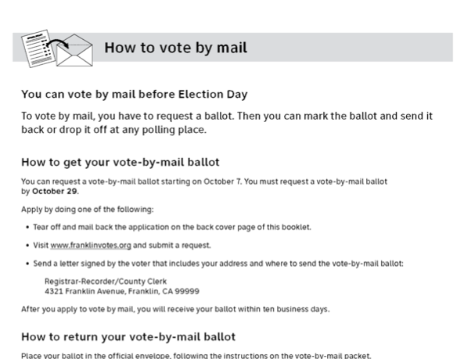
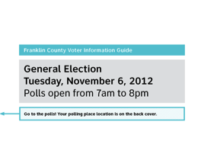
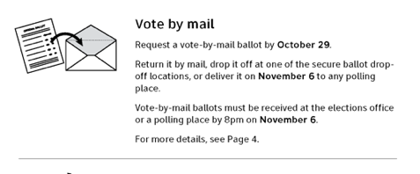
Example of information organized as a bite, snack, and meal
Bite: Shortest possible information
Snack: Summary, with enough information for an experienced voters
Meal: Full details or instructions

Slide 14
Plain language on the menu
The right information: Just what voters need to take the next step
As short as possible: Edit rigorously.
1 word, not 2
Short sentencesS
Short paragraphs
Organized: Use headings and white space to make the structure clear

Slide 15
Ten Lessons
Evidence-based designs for Voter Information Guides
Notes:
Dana

Slide 16
Ten Lessons
TOC
ROV letter
Ways to Vote
Voter Bill of Rights (SOS)
How to vote by mail on a paper ballot on an electronic ballot
Accessible voting and language assistance
Primaries in California
What’s on the Ballot County + State guides
About the candidates
Paid candidate statements
Measures
Covers
Postcard for update registration or update VBM status
Bonus! Ads or filler pages

Slide 17
1. Table of Contents
“What’s in this guide?”

Slide 18
The Table of Contents helps voters find their way
Why?
Helps voters know where they are and where they’re going
What?
Title answers the first question: "What is this"
Use headings to identify the big sections
Include page numbers
Signal languages available
Layout for What’s in this guide?
Notes:
We noticed during our testing that voters referred back to the Table of Contents while looking at specific pages. This behavior gave us confidence that this page met their unspoken needs.
In response to the comments on 2/3/2016, this page might use the title
What’s in this pamphlet?
This page follows the First page in a “chapter” format, as described in our Layout and organization document.

Slide 19
2. Registrar of Voters letter

Slide 20
Letter from the ROV
We used an example in all three counties where we tested.
Voters liked seeing who is responsible for elections.
Frequent voters expect it to highlight what’s new.
We recommend:
Highlight what’s new or changed in the voting process. For example, postmark requirements have changed.
It doesn’t need to be a full page, but place it to introduce the rest of the information in the booklet.
Notes:
Participants in the 2/3/2016 training noted that using the ROV’s script signature or their picture can be considered a form of campaigning. The ROV’s name, office title are fine to accompany the ROV letter.

Slide 21
3. Ways to vote

Slide 22
Ways to vote
Choose the elements that fit your county’s situation
Voter Bill of Rights
How to vote by mail
Early voting
How to vote with paper ballot
How to vote with electronic ballot
How to vote in a primary
Others?

Slide 23
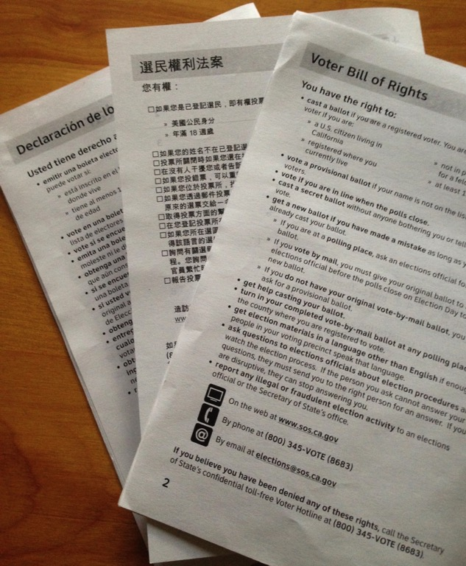
How clear is the Voter Bill of Rights?
Voters struggled with “provisional ballot.”
Surprises (new information for them)
Change in franchise following felony
Replacing a spoiled ballot
Calling in reports of fraud
Can vote, if in line when polls close
Comments and concerns
Requesting a ballot by web, but not voting by web
We expect an updates version from the Secretary of State
Voter Bill of Rights in Spanish, Chinese, and English

Slide 24
3 ways to vote
Describes 3 ways (mail, early, at the polls)
Each way has an illustration as well as text
Helpful to new voters, infrequent voters, and new citizens
Notes:
This is the snack.
This page follows the First page in a “chapter” format, as described in our Layout and organization document.

Slide 25
How to vote by mail
New voters appreciate the detailed instructions about
How to get a VBM ballot
How to return the VMB ballot
Illustrations available to match your county’s ballot marking style, and return options
Notes:
This page (and others like it filling in details of ways to vote) follows the detail format, as described in our Layout and organization document

Slide 26
"Ways to vote" pages can be an "anytime" pamphlet
It can be useful as part of your community outreach for new voters:
Give to voters when they register
Hand out to people about to be eligible (because of age, citizenship status).
Provide official (accurate) information.
Expand on the basic voter rights with accurate information for your county.
Improvements
Make an attractive cover that welcomes new voters, and lists the information included
Possible pages in the booklet
Cover and TOC
California Voter Bill of Rights
3 ways to vote in <this> County
How to vote early
How to vote by mail
How to vote at the polls
How to vote by electronic ballot
Accessible voting
Language assistance
Check your voter registration status

Slide 27
4. Accessibility and languages

Slide 28
Accessibility
Update content for accuracy in your county
Use the layout
For consistency
For navigation aid

Slide 29
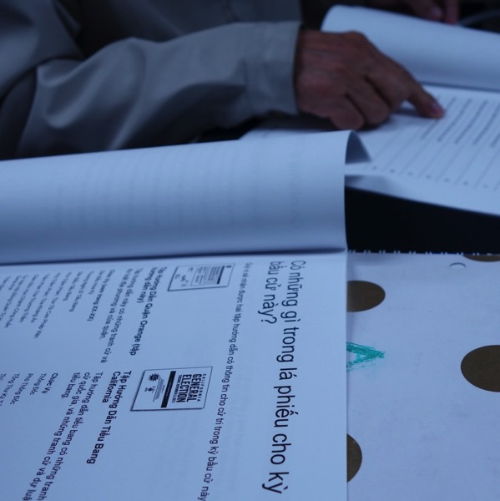
Presenting materials in more than 2 languages
Single and bi-lingual layout samples
Use a consistent layout for all language versions.
Options for layout
Each language in its own section
Facing pages, with English on the right
Most forms will be bilingual
Notes:
Layout notes for multiple languages on the cover are shown within the Layout and organization document.

Slide 30
Icons and illustrations
Icons and illustrations that you need are provided free of charge
Let us know if there’s another illustration needed to fit your situation, and we’ll create it.
File Format | Uses
.jpg | Printed document
.png | Web and screens
.tif | Large posters and banners
Excerpt from icon library
Notes:
We provide icons and illustrations in 3 file types which correspond to 3 intended uses.
Files in .jpg format are good for printing, including banners, poster, and ordinary documents.
Files in .png format are sufficient for screen, including webpages.
Files in .tif format are intended for large format poster or banners.

Slide 31
5. Primaries in California

Slide 32
Primaries in California
Many regular voters had difficulty explaining or understanding the top 2 primary system.
The 3 column treatment for the 3 categories of contests worked best with new voters and new citizens. This version has 4 sections
Who is eligible?
Who can vote in each type of primary?
How do we know who won?
Which offices are in each type of primary?
How to vote in a primary election
Notes:
Notice the structure combines a table layout, with Q&A.
At a glance it’s clear that there are 3 columns, which helped voters see that there are three different types of primaries.

Slide 33
6. What’s on the ballot

Slide 34
What’s on the ballot
This page is new.
Voters don't understand that there are two guides, or why. – but an “aha!” moment when they recognized the State guide’s cover
Putting the information side by side shows how the two guides fit together.
Notes:
This page follows the First page in a “chapter” format, as described in our Layout and organization document.

Slide 35
7. About the candidates

Slide 36
About the candidates
Update content as needed for current election
About the candidates
Endorsements
Try new formatting
For consistency
For navigational aid
Consider a 2-column layout for bilingual guides

Slide 37
8. Paid candidate statements

Slide 38
Paid candidate statements
Updating content to this year’s candidates.
Try the new formatting
For consistency
For navigational aid
Easily adaptable to bilingual treatment

Slide 39
9. Measures

Slide 40
Measure has up to 5 content elements
Overview
Ballot question - Your vote means (yes|no) - For and Against
Impartial analysis | Fiscal impact statement
Arguments for Measure | Arguments against Measure
Full text
Notes:
New:
Overview
Ballot Question in the guide

Slide 41
Measures: Overview is new
Will a Measure Overview page fit within your page count and budget?
j
a
Recommended layout of elements on Overview, plus order of remaining pages
1. Overview
Ballot title and question
What your vote means
For and against Measure K
2. Analysis
3. Financial impact
4. Arguments / Replies
5. Full text
b
c
Layout of a bilingual Overview page
Notes:
We learned
An overview page helps the voter understand the big picture.
What are we voting about?
What does my vote mean?
Who in my community supports or opposes this measure?
This page follows the detailed contents format, as described in our Layout and organization document. There is a specific description of this page starting on the page numbered 7.

Slide 42
Measures: Order of elements in packet
1. The ballot title and question orient voters: “What am I deciding?”
Recommended element order
1. Overview: Ballot title and question What your vote means For/Against (endorsers)
2. Impartial Analysis
3. Financial impact (where appropriate)
4. Arguments / Replies
5. Full text
4. Arguments for and against on one page
Replies to the arguments on the next page
2. & 3. The analysis and financial impact each give a short summary of the issue, and answer questions, such as “Why are we deciding this?”
5. Full text last, because it can be very long
Notes:
Make the text as large as possible, especially on the first page, so it is inviting.
We use language that more voters understand:
- Reply (rather than Rebuttal)
Without an overview page, the order of the information in the prototype does not work well. Voters are not ready to read the arguments, before seeing the ballot language and some introduction to the question.
New voters had trouble understanding that the question itself is on the ballot.
We recommend full text last, so that the voter gets to bite and snack before diving into the whole meal.

Slide 43
Measures: Impartial analysis
We recommend
Copy the statements from the Impartial analysis spelling out what Yes and No votes mean, and repeat these statements on each measure’s first (or Overview) page.
We offer 2 choices for how to format What your vote means. Ask about other ways to preview the meaning of the voter’s Yes or No.
Example formatted as text paragraphs
Example formatted as table
Notes:
Impartial analysis is recognized as trustworthy by voters.
It’s often difficult to know what your vote means, because of the way a ballot measure is phrased.
Most voters recall being confused by a measure phrased as a negative - for which voting “no” means supporting the substance of the measure.
Note: There was a discussion at New Law (12/2015) about requiring the counsel to write the Yes/No statements for counties where this is not already current practice.
Alternatively, since the statements are usually at the end of the analysis, AND if the analysis fits on the first page, we suggest asking the county counsel to include a heading "What your vote means" to make the information more useful

Slide 44
Measures: Page numbers for easier production
We recommend “chapter numbering” for the measures
Solves the production problem.
Makes it easier for the voter to find the measure when flipping through the guide.
Eliminate page number references for individual measures in the TOC
For the Table of Contents, omit the list of measures, and just show the opening page number.
In What’s on this Ballot, omit the the “see pages…” references.
The problem:
Some large counties create ballot style books by assembling all of the contests and measures on that ballot. This assembly process makes consecutive page numbering difficult.
Notes:
These pages follow the detailed page format, as described in our Layout and organization document.

Slide 45
10. Covers

Slide 46
Cover templates
We show treatments for 1, 2, or 3 languages
The design aims for a consistent look across all 58 counties
Front cover
County seal
Date/Time of election
Inside front
ROV Letter
Inside back
Update registration
Back cover
Voter name and address,
Address for polling place
Notes:
Even when a voter moves within California, they’ll know it’s an official election guide because it looks like it!

Slide 47
Anatomy of the Front Cover
County seal identifies this document as official, at a glance.
Title of the book
Name and key information about this election
Where’s my polling place?
Contact information for the Elections Office in relevant languages
Notes:
Key information on this page - County
- Title of book
Election
Where’s your polling place
Contact info
Plenty of white space – no distractions from the messages.

Slide 48
Bonus! Ads & Filler

Slide 49
Why filler?
Need content to fill 4 pages in a signature, no blanks
Possible content
Attract pollworkers
Remind voters of deadlines to request vote by mail ballots or return vote by mail ballots
Give more information on accessibility
Advertise other county agencies and services
What suggestions do we have?
Match the style to this new look

Slide 50
Next steps

Slide 51
Next steps
Today
Work in pairs on one or two pieces each
Consider relevance, brevity and structure in revising and creating pages
Check in with
Center for Civic Design
Your colleagues who have been through the training
Next few weeks
Continue revising as you can
Work with neighbors and with Center for Civic Design team: We are eager to learn about your county’s special issues and help solve them.
Allison can help with code issues and moral support!
Eventually
We want to see your finished work, to add to our collection of all materials used in California’s 2016 primary and general elections (as we did in 2014).
Notes:
We love your feedback, because it will help us improve this training for the new group on March 1.
We (CCD) are happy to help, and you can call on Allison for moral support and to discuss code issues
We’d love to see your work for our collection.
We will be collectiong of all voter guides in the state for the primary and general, as we did in 2014
If you need any illustrations, or variations on the current ones, let us know
Thanks for being here!

Slide 52
Thanks are due!

Slide 53
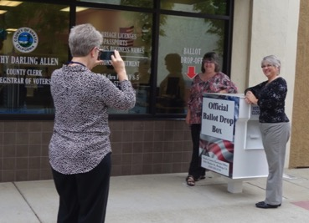
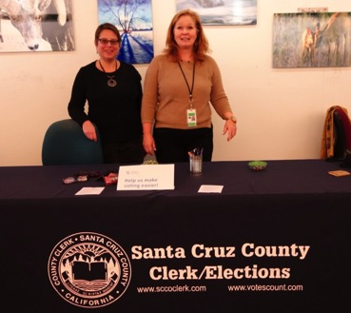
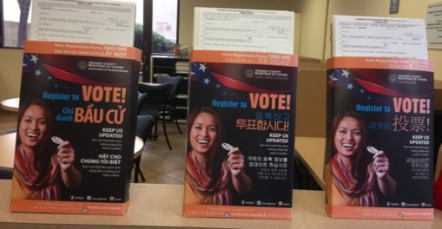
Thanks to
Our funders and partners
Irvine Foundation and the Future of California Elections
League of Women Voters of California Education Fund
Shasta, Santa Cruz and Orange Counties
Our colleagues at Oxide Design
Our hosts
Glenn County
And you!
For spending time learning about how to improve your Voter Guide.

Slide 54
Get in touch! Nancy Frishberg nancyf@civicdesign.org Whitney Quesenbery whitneyq@civicdesign.org civicdesign.org @civicdesign

